Slide 1
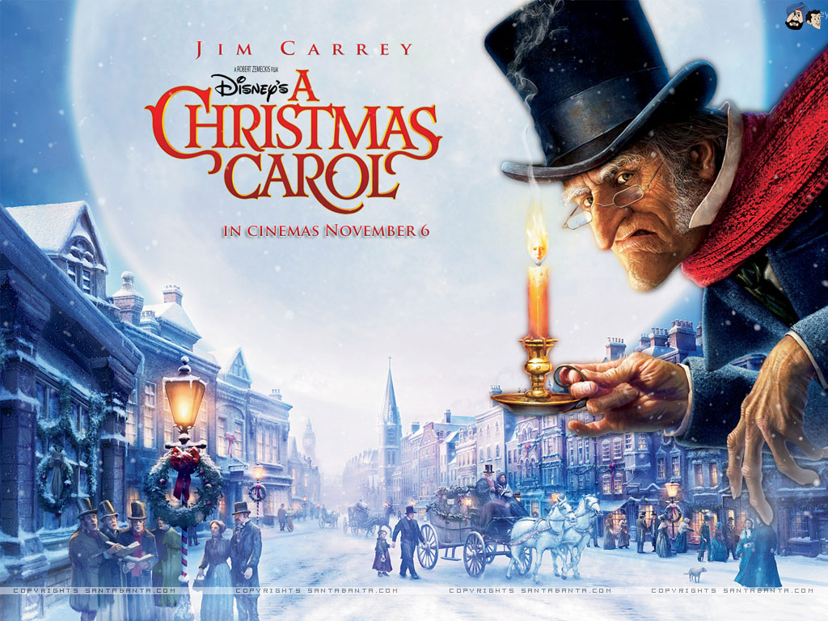
LO: inference skills Monday 9th November 2020

Slide 2
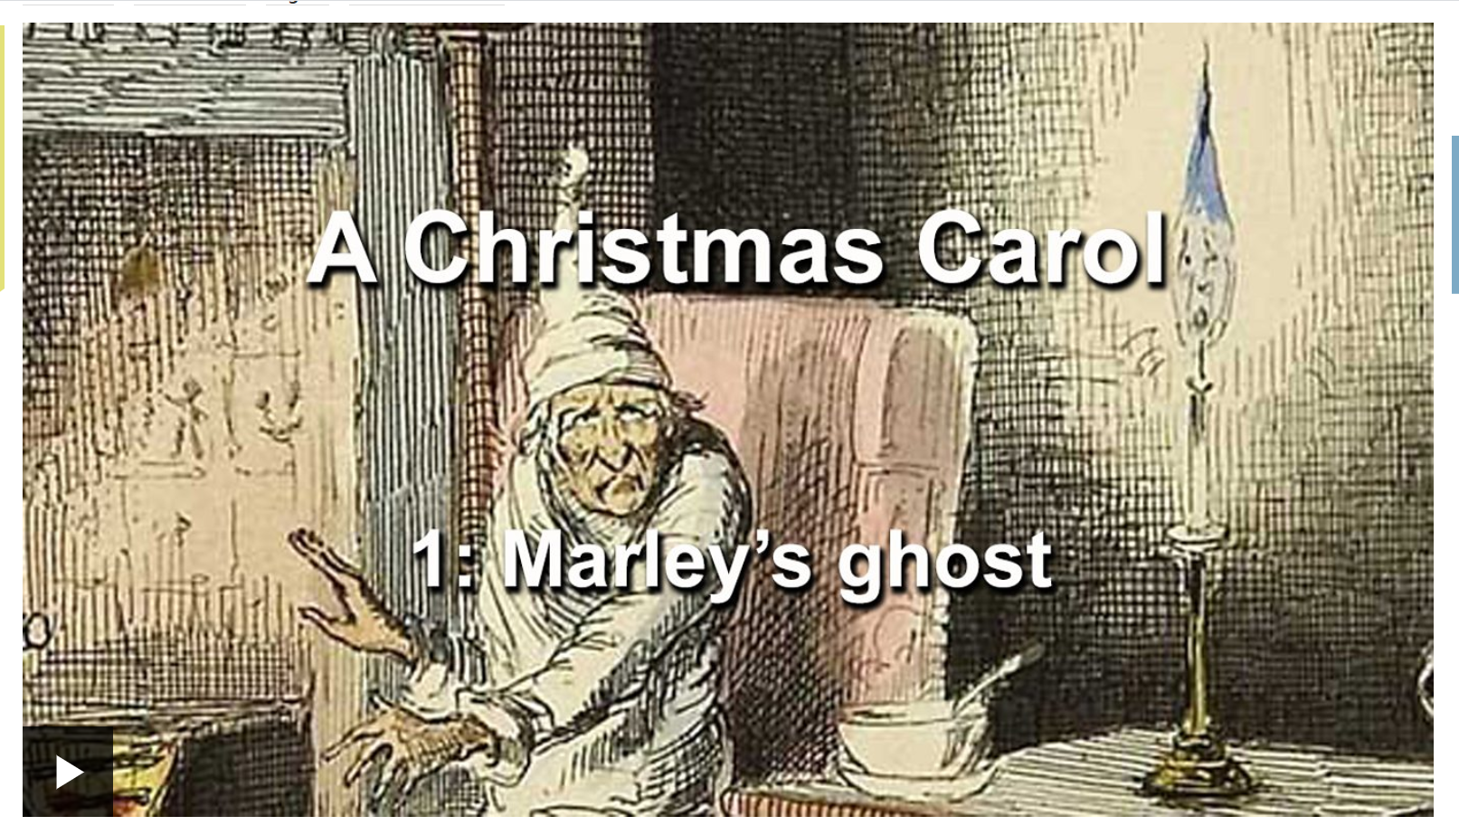
Listen and read along to Episode One: Marley’s Ghost
https://www.bbc.co.uk/teach/school-radio/english-ks2-a-christmas-carol-episode-1-marleys-ghost/zrb78xs

Slide 3
Episode One
What is tension?
What is suspense?
How does Dickens build tension throughout Stave One?

Slide 4
Synonyms and shades of meaning
scared | horrified | frightened
terrified | petrified | jittery
alarmed | on-edge | spooked
anxious | nervous | perturbed
worried | fearful | unsettled

Slide 5
Reader’s Toolbox
Inference
Clarification
Justification
Scanning
Prediction

Slide 6
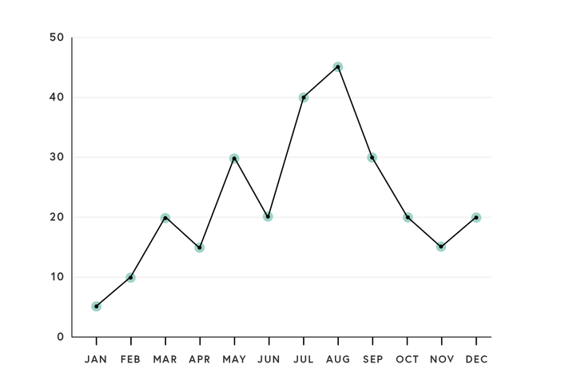
What do line graphs show?
Line graphs track a variable over time.

Slide 7
We are going to plot Scrooge’s emotions over Chapter One on a line graph...

