Slide 1
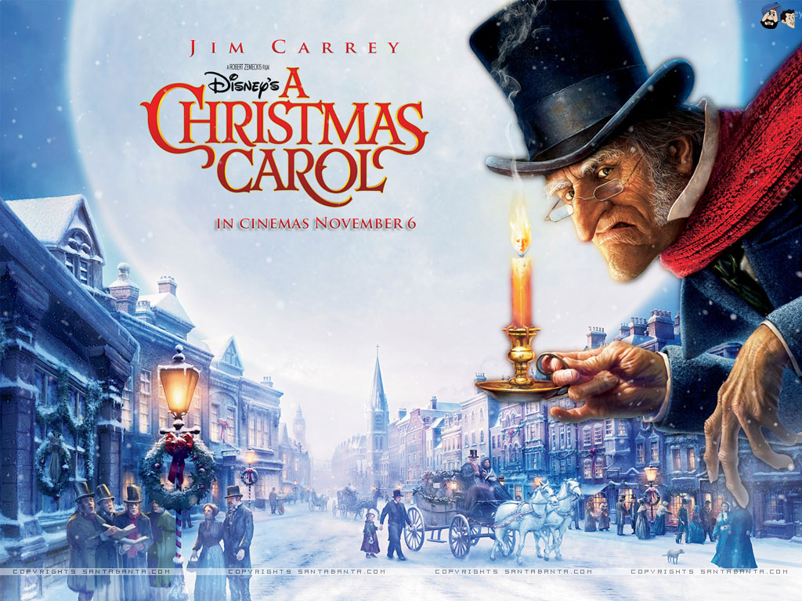
LO: write a character description in the style of Dickens
Tuesday 10th November 2020

Slide 2
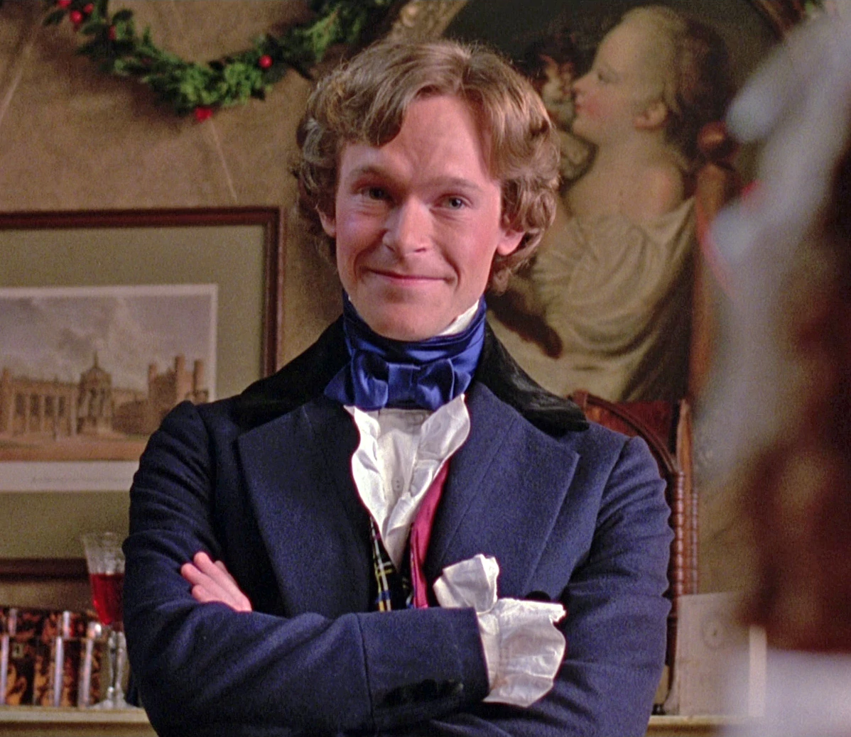
Scan through Stave One… what words or phrases can you find that describe Fred?

Slide 3
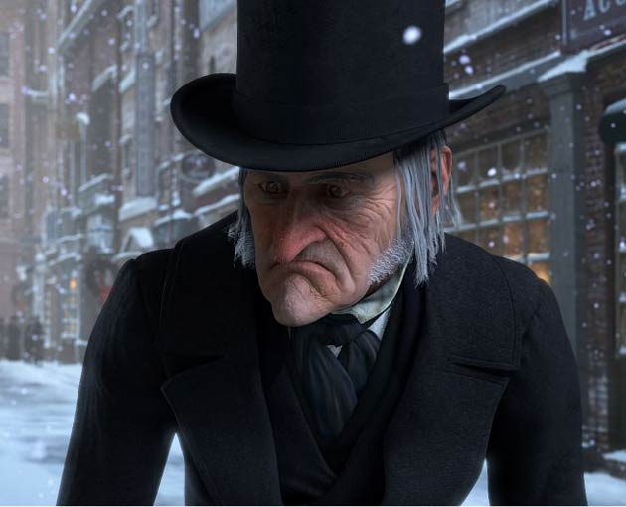
How has Dickens used juxtapositioning?

Slide 4
Here is Dickens’s description of Scrooge...
Hard and sharp as flint, from which no steel had ever struck out generous fire; secret and self-contained, and solitary as an oyster. The cold within him froze his old features, nipped his pointed nose, shrivelled his cheek, stiffened his gait; made his eyes red, his thin lips blue; and spoke out shrewdly in his grating voice. A frosty rime was on his head, and on his eyebrows, and on his wiry chin. No wind that blew was bitterer than he, no falling snow was more intent upon its purpose.

Slide 5
Can we create our own description of Fred in a Dickensian style? Try changing the words or phrases in red.
Hard and sharp as flint, was old Ebeneezer; secret and self-contained, and solitary as an oyster. The cold within him froze his old features, nipped his pointed nose, shrivelled his cheek, stiffened his gait; made his eyes red, his thin lips blue; and spoke out shrewdly in his grating voice. A frosty rime was on his head, and on his eyebrows, and on his wiry chin. No wind that blew was bitterer than he, no falling snow was more intent upon its purpose.

