Slide 1
LO: equivalent fractions
9.11.20

Slide 2
Equivalent fractions: same value, different appearance...

Slide 3
Use the models to write equivalent fractions...

Slide 4
Equivalent fractions: same value, different appearance...

Slide 5
Whatever is done to the numerator must be done to the denominator...

Slide 8
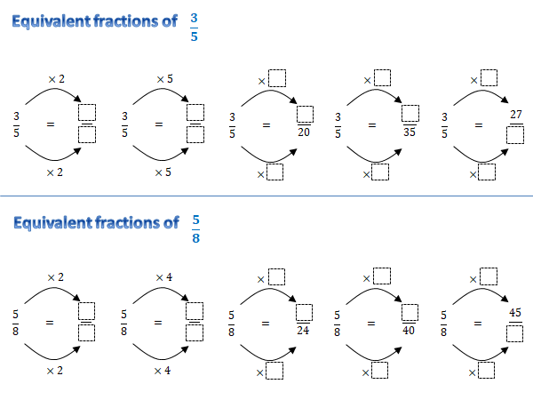

Slide 10
Whatever is done to the numerator must be done to the denominator...

