Slide 1
LO: improper fractions to mixed numbers
11.11.20

Slide 2
Improper fractions have numerators greater than the denominator

Slide 3
Improper fractions have numerators greater than the denominator

Slide 4
Vote!

Slide 5
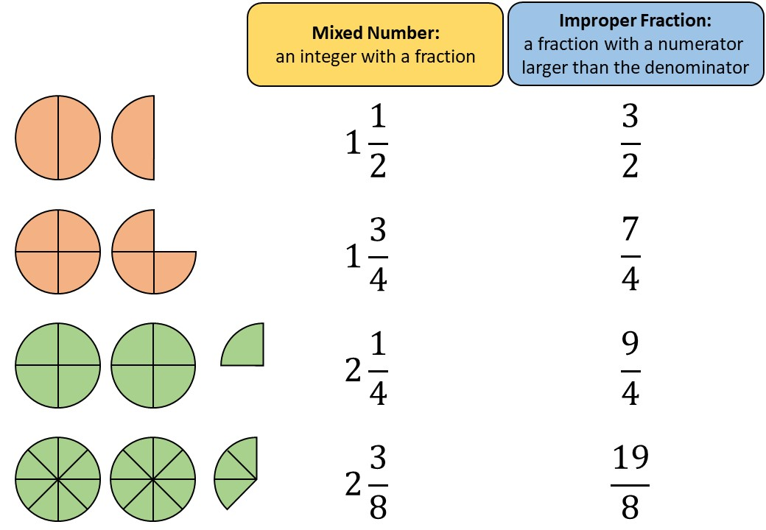

Slide 6
Success checklist to change improper fraction to mixed number:
Numerator ÷ Denominator
Express your remainder as a fraction, keeping the original denominator

