Slide 3
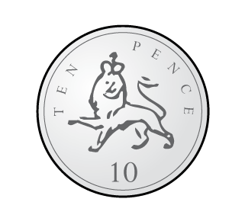
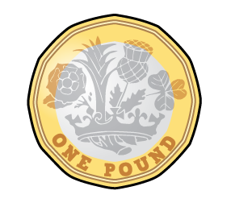
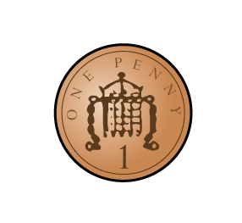
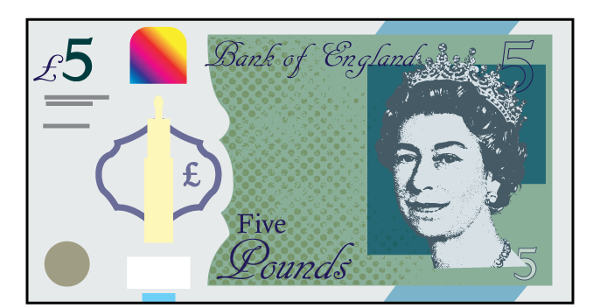
Do these have the same value?
£6 and 43p
£4 and 63p

Slide 4
Do these have the same value?
£6 and 43p
£4 and 63p

Slide 6
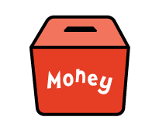
$$>$$
Have a think

Slide 7
$$<$$

Slide 8
$$=$$

Slide 9
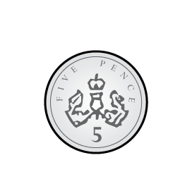
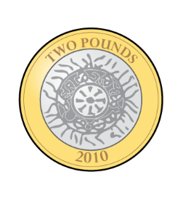
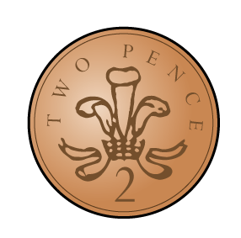
Oh no he doesn’t!
$$>$$
Ron has more!

Slide 10
Oh no he doesn’t!
It’s the value that is important
?
Have a think
Ron has more!

Slide 11
Oh no he doesn’t!
It’s the value that is important
$$<$$

Slide 12
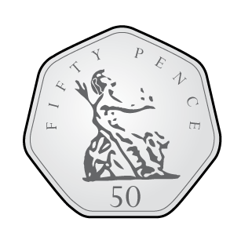
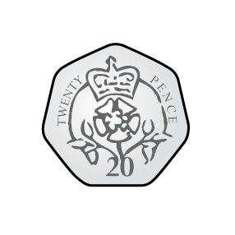
It’s the value that is important
$$<$$
?
Have a think
Ron has a note!

Slide 13
Have a go at questions 1 - 5 on the worksheet

Slide 14
I have £40 and 12p saved in my bank
I have £28 and 88p saved in my bank
$$>$$
?

Slide 15
I have £12 and 12p saved in my bank
I have £12 and 88p saved in my bank
$$<$$
?

Slide 16
Have a go at question 6 on the worksheet

Slide 17
I have
£10 and 0p
saved in my bank
I have
£9 and 99p
saved in my bank
$$>$$
I have
£2 and 75p
saved in my bank
I have
£9 and 99p
saved in my bank
$$<$$
Notes:
Dora, Whitney and Teddy are on a role now.
But this one looks different! Let’s see if they can use what they know
Whitney knows that 100 take away 40 is equal to 60
And Dora knows that 60 take away 2 is equal to 58
So Teddy has realised that 100 takeaway 42 must be equal to 58
Great team work guys!

Slide 18
Have a go at question 7 on the worksheet

