Slide 1
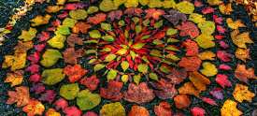
Art in Nature
In the next few weeks we are going to study the work of the artist, Andy Goldsworthy.
Read about him and his work now.

Slide 2
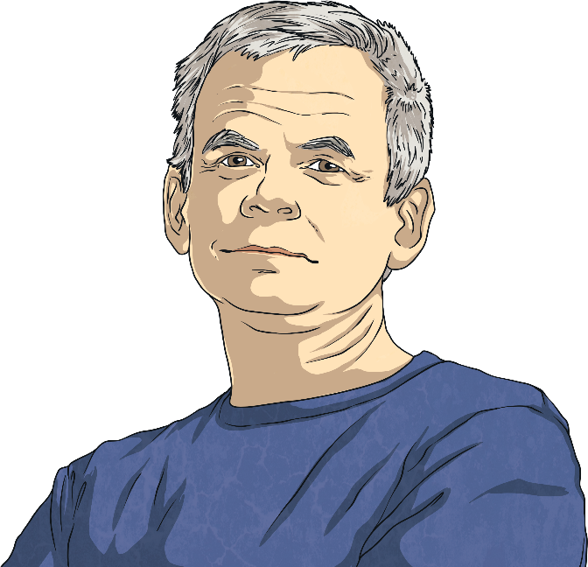
Andy Goldsworthy
Andy Goldsworthy is a British artist. He is known for his work in sculpture and photography. Andy is an environmentalist and this is reflected in the nature-based aspect of much of his work.
Andy was born on 25th July 1956 in Cheshire. When Andy was 13, he got a job as a labourer on a farm.
He studied fine art at Bradford College of Art. Fine art is a form of art that is intended only to be viewed and enjoyed, as opposed to art that has a practical use, like architecture.
Did You Know?
Andy said his work on the farm helped prepare him for creating sculptures later in life. He said, “A lot of my work is like picking potatoes; you have to get into the rhythm of it.”

Slide 3
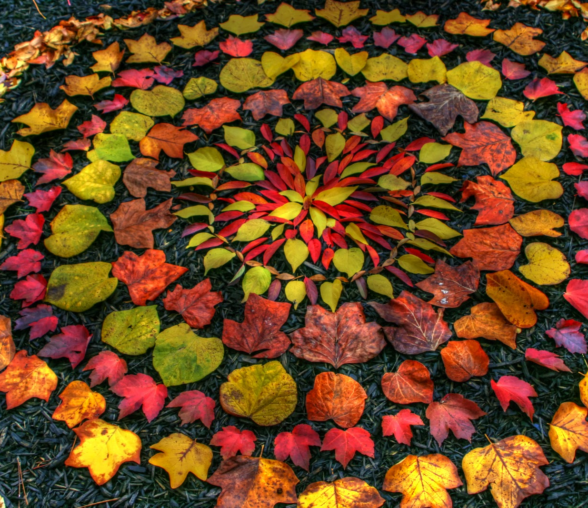
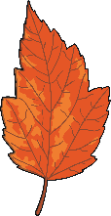
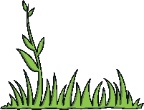
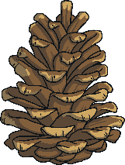
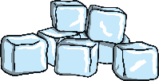
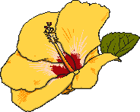
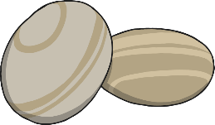
Land Art
Andy makes sculptures with natural materials on sites in the UK and around the world. He has made them in forests, fields, cities, lakes and fields. They are known as land art.
Which natural materials can
you think of that he could use
to make sculptures?
leaves
twigs
pebbles
rocks
ice
flowers
grass
pine cones
Did You Know?
Andy has even used human hair and cow dung in his work!

Slide 4
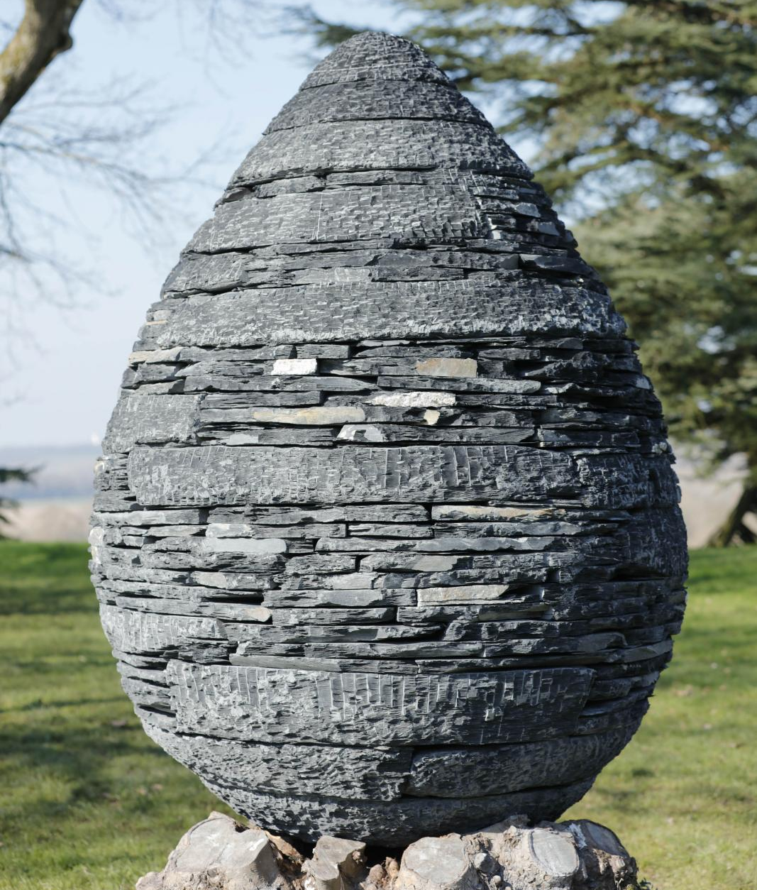
Photography
As well as making sculptures,
Andy takes photographs of his
work over time to show how they
change.
Talk About It
Why do you think his sculptures
change?
Did You Know?
Andy was given an OBE by the
Queen in 2000. This is a very
special award that the Queen gives
to only a few people each year.

Slide 5
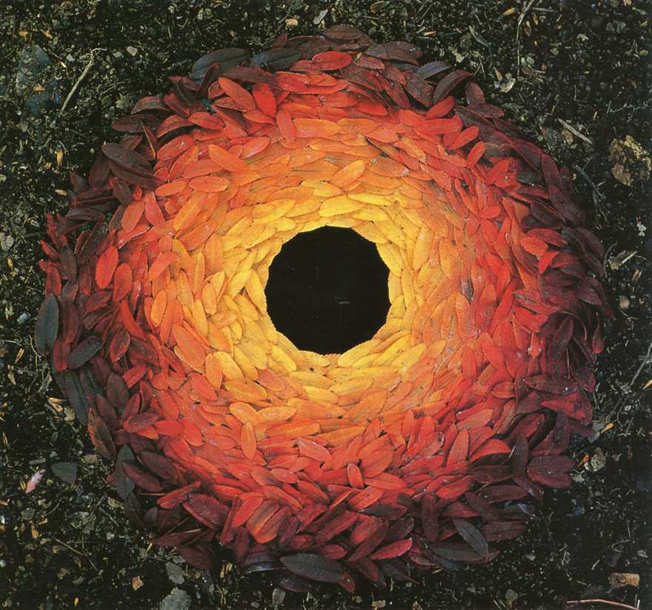
Maple Leaf Arrangement
This is one of Andy Goldsworthy’s most famous pieces of art. It is made from maple leaves.
Create your own piece of art based on this by cutting out leaf shapes, colour them in autumn colours and arrange them to create a pattern.

Slide 6
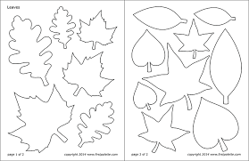
Use these templates to create your leaves or draw your own.

