Slide 1
Amesbury Archer
History- Wednesday 18th November

Slide 2
What are we learning?
I can discuss who the Amesbury Archer is and his significance to the Bronze Age.

Slide 3
Who is the Amesbury Archer?
In 2002, archaeologists at Amesbury, in Wiltshire made an amazing find. They discovered the grave of a Bronze Age man, just two miles from Stonehenge.
He was buried with around 100 objects! The people who buried him must have believed that he would use the objects in the next world.

Slide 4
Why the Amesbury Archer?
When the man was found, he was nicknamed 'the Amesbury Archer'. This was because he was buried with arrowheads and wrist-guards used by archers.
In fact, the Amesbury Archer probably spent most of his time working with metal. One of the objects in his grave was a cushion stone - a tool used by metalworkers.

Slide 5
The bones of the man found inside showed that he was a strong man, who had lived to be 35 to 45 years old - a good age to have reached in the Early Bronze Age.
At his death, his mourners buried him in the way that was typical of the time, on his side and slightly curled up, as if he was asleep. The offerings placed beside him were very typical of the time, however what is unusual is the sheer quantity of these grave goods.

Slide 6
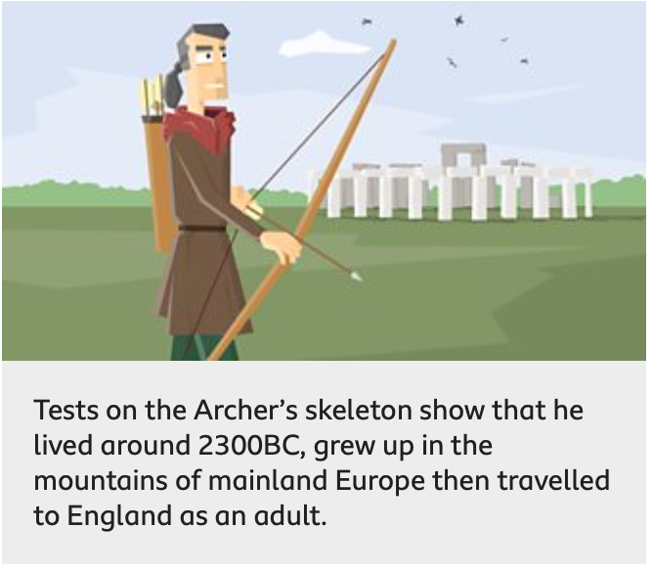

Slide 7
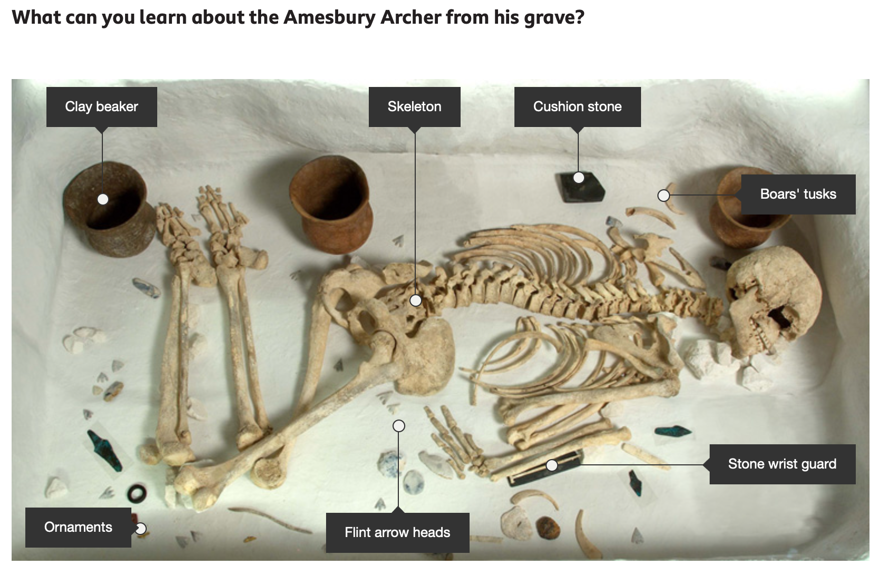
https://www.bbc.co.uk/bitesize/topics/z82hsbk/articles/z874kq t

Slide 8
Your job
Your job is to create a poster about the Amesbury Archer, explaining who he was and why he is significant.

