Slide 3




1) Convert these mixed numbers to improper fractions:
2) Convert these improper fractions to mixed numbers:
2 $\frac{\text{1}}{\text{4}}$
3 $\frac{\text{3}}{\text{5}}$
$\frac{\text{16}}{\text{5}}$
$\frac{\text{18}}{\text{7}}$

Slide 4






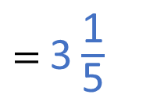



1) Convert these mixed numbers to improper fractions:
2) Convert these improper fractions to mixed numbers:
$=$ $\frac{\text{9}}{\text{4}}$
$=$ $\frac{\text{18}}{\text{5}}$
2 $\frac{\text{1}}{\text{4}}$
3 $\frac{\text{3}}{\text{5}}$
2 $\text{×}\frac{\text{4}}{\text{4}}=$ $\frac{\text{8}}{\text{4}}$
$\frac{\text{8}}{\text{4}}+$ $\frac{\text{1}}{\text{4}}$
3 $\text{×}\frac{\text{5}}{\text{5}}=$ $\frac{\text{15}}{\text{5}}$
$\frac{\text{15}}{\text{5}}+$ $\frac{\text{3}}{\text{5}}$
$=$ 3 $\frac{\text{1}}{\text{5}}$
$\frac{\text{16}}{\text{5}}$
$\frac{\text{18}}{\text{7}}$
$=$ 2 $\frac{\text{4}}{\text{7}}$

Slide 6

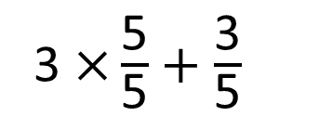
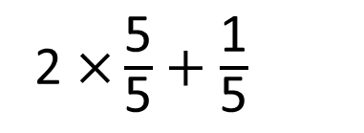

2 $\frac{\text{1}}{\text{5}}$ $+$ 3 $\frac{\text{3}}{\text{5}}$ $=$
$$\frac{\text{29}}{\text{5}}$$
or 5 $\frac{\text{4}}{\text{5}}$
I’m going to convert both mixed numbers to improper fractions first
2 $\frac{\text{1}}{\text{5}}$ $=$ $\frac{\text{1}\text{1}}{\text{5}}$
3 $\frac{\text{3}}{\text{5}}$ $=$ $\frac{\text{18}}{\text{5}}$
3 $\text{×}\frac{\text{5}}{\text{5}}$ $+$ $\frac{\text{3}}{\text{5}}$
2 $\text{×}\frac{\text{5}}{\text{5}}$ $+$ $\frac{\text{1}}{\text{5}}$

Slide 7
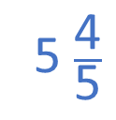
2 $\frac{\text{1}}{\text{5}}$ $+$ 3 $\frac{\text{3}}{\text{5}}$ $=$
5 $\frac{\text{4}}{\text{5}}$
I’m going to add my whole numbers and fractions separately.
2 $+$ 3 $=$ 5
$\frac{\text{1}}{\text{5}}$ $+$ $\frac{\text{3}}{\text{5}}$ $=$ $\frac{\text{4}}{\text{5}}$

Slide 8
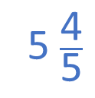

I’m going to convert them both to improper fractions first
2 $\frac{\text{1}}{\text{5}}$ $=$ $\frac{\text{1}\text{1}}{\text{5}}$
3 $\frac{\text{3}}{\text{5}}$ $=$ $\frac{\text{18}}{\text{5}}$
2 $\frac{\text{1}}{\text{5}}$ $+$ 3 $\frac{\text{3}}{\text{5}}$ $=$
$$\frac{\text{29}}{\text{5}}$$
or 5 $\frac{\text{4}}{\text{5}}$
I’m going to add my whole numbers and fractions separately.
$\frac{\text{1}}{\text{5}}$ $+$ $\frac{\text{3}}{\text{5}}$ $=$ $\frac{\text{4}}{\text{5}}$
2 $+$ 3 $=$ 5
2 $\frac{\text{1}}{\text{5}}$ $+$ 3 $\frac{\text{3}}{\text{5}}$ $=$
5 $\frac{\text{4}}{\text{5}}$
Whose method do you prefer? Why?
Have a think

Slide 9
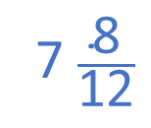

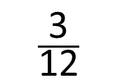
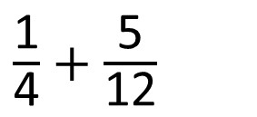
3 $\frac{\text{1}}{\text{4}}$ $+$ 4 $\frac{\text{5}}{\text{12}}$ $=$
7 $\frac{\text{8}}{\text{12}}$
$\frac{\text{1}}{\text{4}}$ $+$ $\frac{\text{5}}{\text{12}}$
$×$ 3
$$\frac{\text{3}}{\text{12}}$$
3 $+$ 4 $=$ 7
$\frac{\text{3}}{\text{12}}$ $+$ $\frac{\text{5}}{\text{12}}$ $=$ $\frac{\text{8}}{\text{12}}$

Slide 10
Have a go at questions 1 - 2 on the worksheet

Slide 11

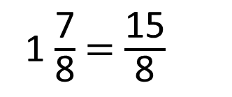
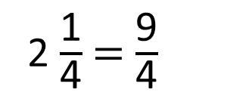
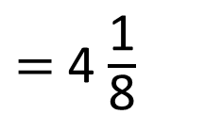





2 $\frac{\text{1}}{\text{4}}$ $+$ 1 $\frac{\text{7}}{\text{8}}$ $=$
$\frac{\text{1}}{\text{4}}$ $=$ $\frac{\text{2}}{\text{8}}$
3 $\frac{\text{9}}{\text{8}}$
2 $+$ 1 $=$ 3
$\frac{\text{2}}{\text{8}}$ $+$ $\frac{\text{7}}{\text{8}}$
2 $\frac{\text{1}}{\text{4}}$ $=$ $\frac{\text{9}}{\text{4}}$
1 $\frac{\text{7}}{\text{8}}$ $=$ $\frac{\text{15}}{\text{8}}$
$\frac{\text{18}}{\text{8}}$
$+$ $\frac{\text{15}}{\text{8}}$
$$\frac{\text{33}}{\text{8}}$$
$=$ 4 $\frac{\text{1}}{\text{8}}$
Have a think

Slide 12
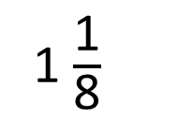

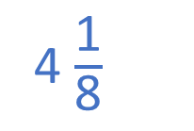
2 $\frac{\text{1}}{\text{4}}$ $+$ 1 $\frac{\text{7}}{\text{8}}$ $=$
1 $\frac{\text{1}}{\text{8}}$
$\frac{\text{9}}{\text{8}}$
2 $+$ 1 $=$ 3
4 $\frac{\text{1}}{\text{8}}$

Slide 13
Have a go at questions 3 - 6 on the worksheet

Slide 14

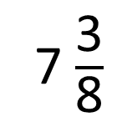
2
1
1
2
2 $\frac{\text{1}}{\text{4}}+$ 2 $\frac{\text{3}}{\text{4}}=$
6
7 $\frac{\text{3}}{\text{8}}$
5
3
1
2
4
4
3 $\frac{\text{3}}{\text{6}}+$ 5 $\frac{\text{7}}{\text{3}}=$
$\frac{\text{7}}{\text{6}} =$
6
Have a think

Slide 15
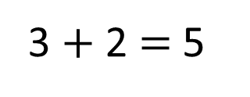
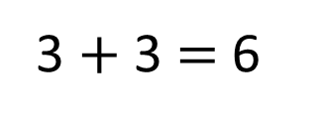


4
1
36
3 $\frac{\text{3}}{\text{6}}+$ 5 $\frac{\text{7}}{\text{3}}=$
2
$\frac{\text{7}}{\text{6}} =$
3
6
3 $+$ 2 $=$ 5
3 $+$ 3 $=$ 6
4
1
$\frac{\text{3}}{\text{6}}+$ $\frac{\text{7}}{\text{3}} =$ 1
$\frac{\text{2}}{\text{6}}$

Slide 16
Have a go at the rest of the questions on the worksheet

