Slide 1
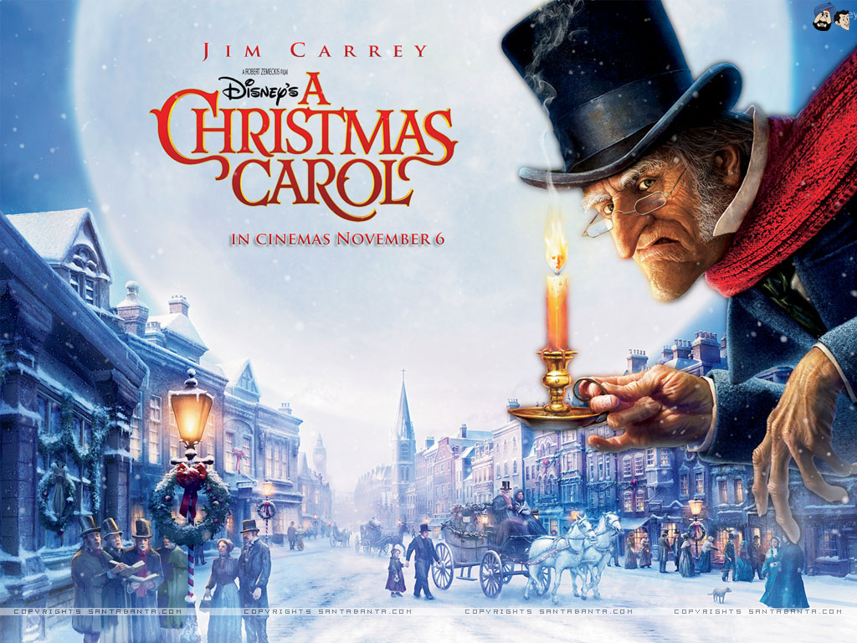
LO: reading comprehension Wednesday 18th November 2020

Slide 2
Listen and follow along to Episode Three: The first of the three spirits
https://www.bbc.co.uk/teach/school-radio/english-ks2-a-christmas-carol-episode-3-the-first-of-three-spirits/zbpkgwx

Slide 3
Reading Comprehension

Slide 4
Types of reading comprehension questions

Slide 5
Types of reading comprehension questions

Slide 6
Types of reading comprehension questions

Slide 7
Types of reading comprehension questions
You will be given a mixture of all of these types of questions in your reading exam.

