Slide 1
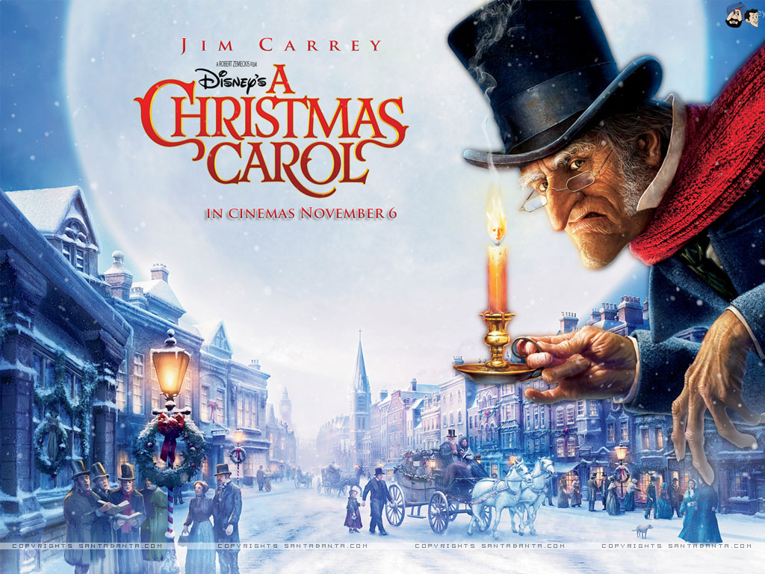
LO: to compare and contrast characters
Monday 23rd November 2020

Slide 2
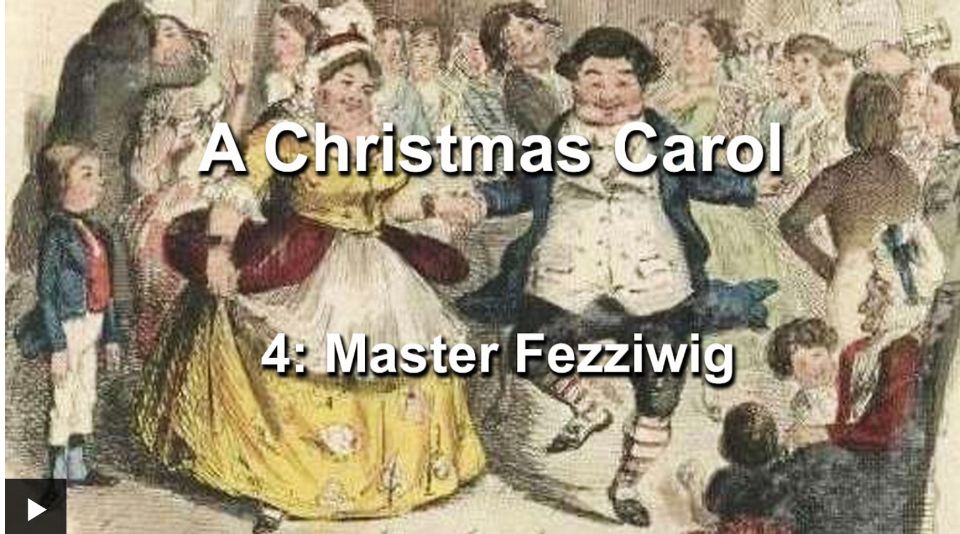
Listen and follow along to Episode Four: Master Fezziwig
https://www.bbc.co.uk/teach/school-radio/english-ks2-a-christmas-carol-episode-4-master-fezziwig/zjkpmfr

Slide 3
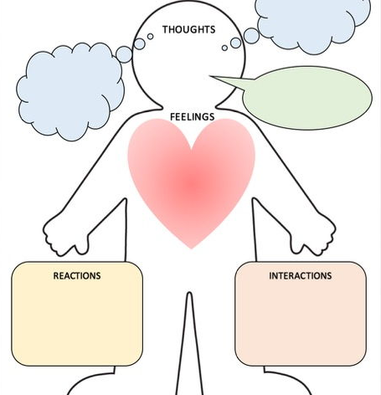
What do we know about the characters?

Slide 4
Ebenezer Scrooge

Slide 5
Master Fezziwig

Slide 6
Ebenezer Scrooge | Master Fezziwig

Slide 7
LO: formal writing and subjunctive form Tuesday 24th November 2020

Slide 13
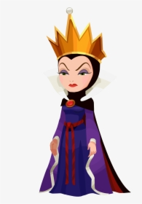

Slide 14
Identify the subjunctive...

Slide 15
Create a formal invitation to the Fezziwig Christmas Ball… can you incorporate the subjunctive?
What are the features of an invitation? What details or information must be included?

