Slide 1
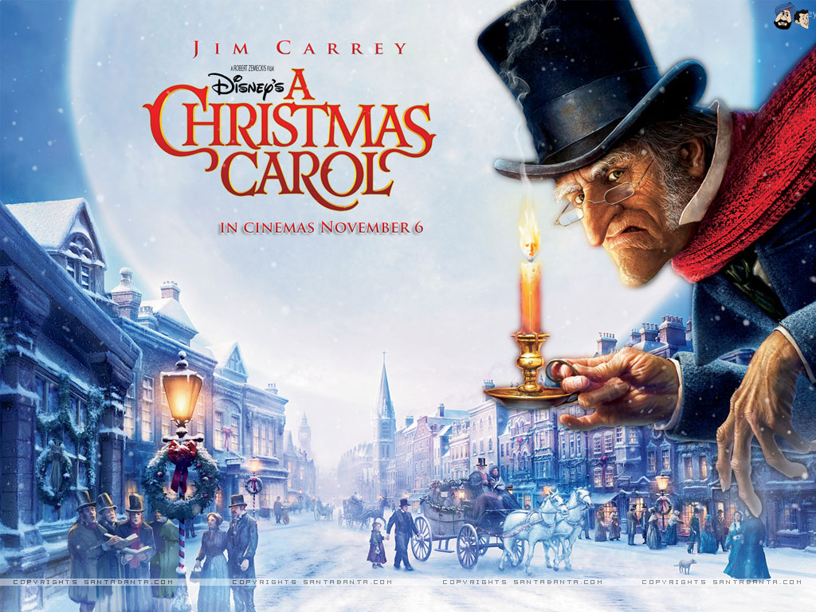
LO: to conduct a character interview Monday 30th November 2020

Slide 2
Warm-up task…
5 things we know about Ebenezer Scrooge…
5 things we would like to know about Ebenezer Scrooge…

Slide 3
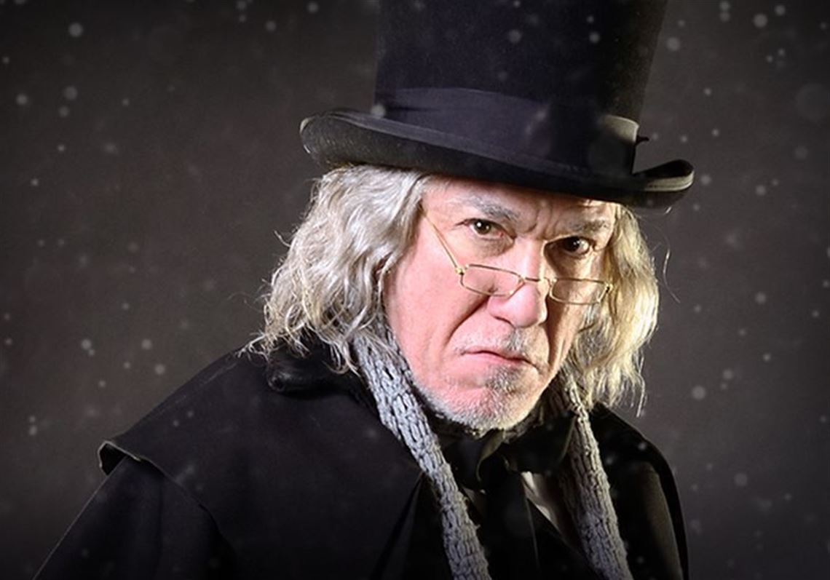
Questions…
Imagine you are a reporter. What questions would you like to ask Mr. Scrooge?

Slide 4
Some good examples of open-ended questions…
Mr. Scrooge, what made you so bitter?
How did you feel when you saw Marley’s face in your door knocker?
What was it about Master Fezziwig that made him a good employer?
What sort of employer do you think you’ve been to Bob Cratchit?
Do you have any regrets after what the Ghost of Christmas Past revealed to you?
How did you feel when your unloving father sent you away to boarding school?
So far, what has frightened you the most about being visited by the ghosts?

Slide 5
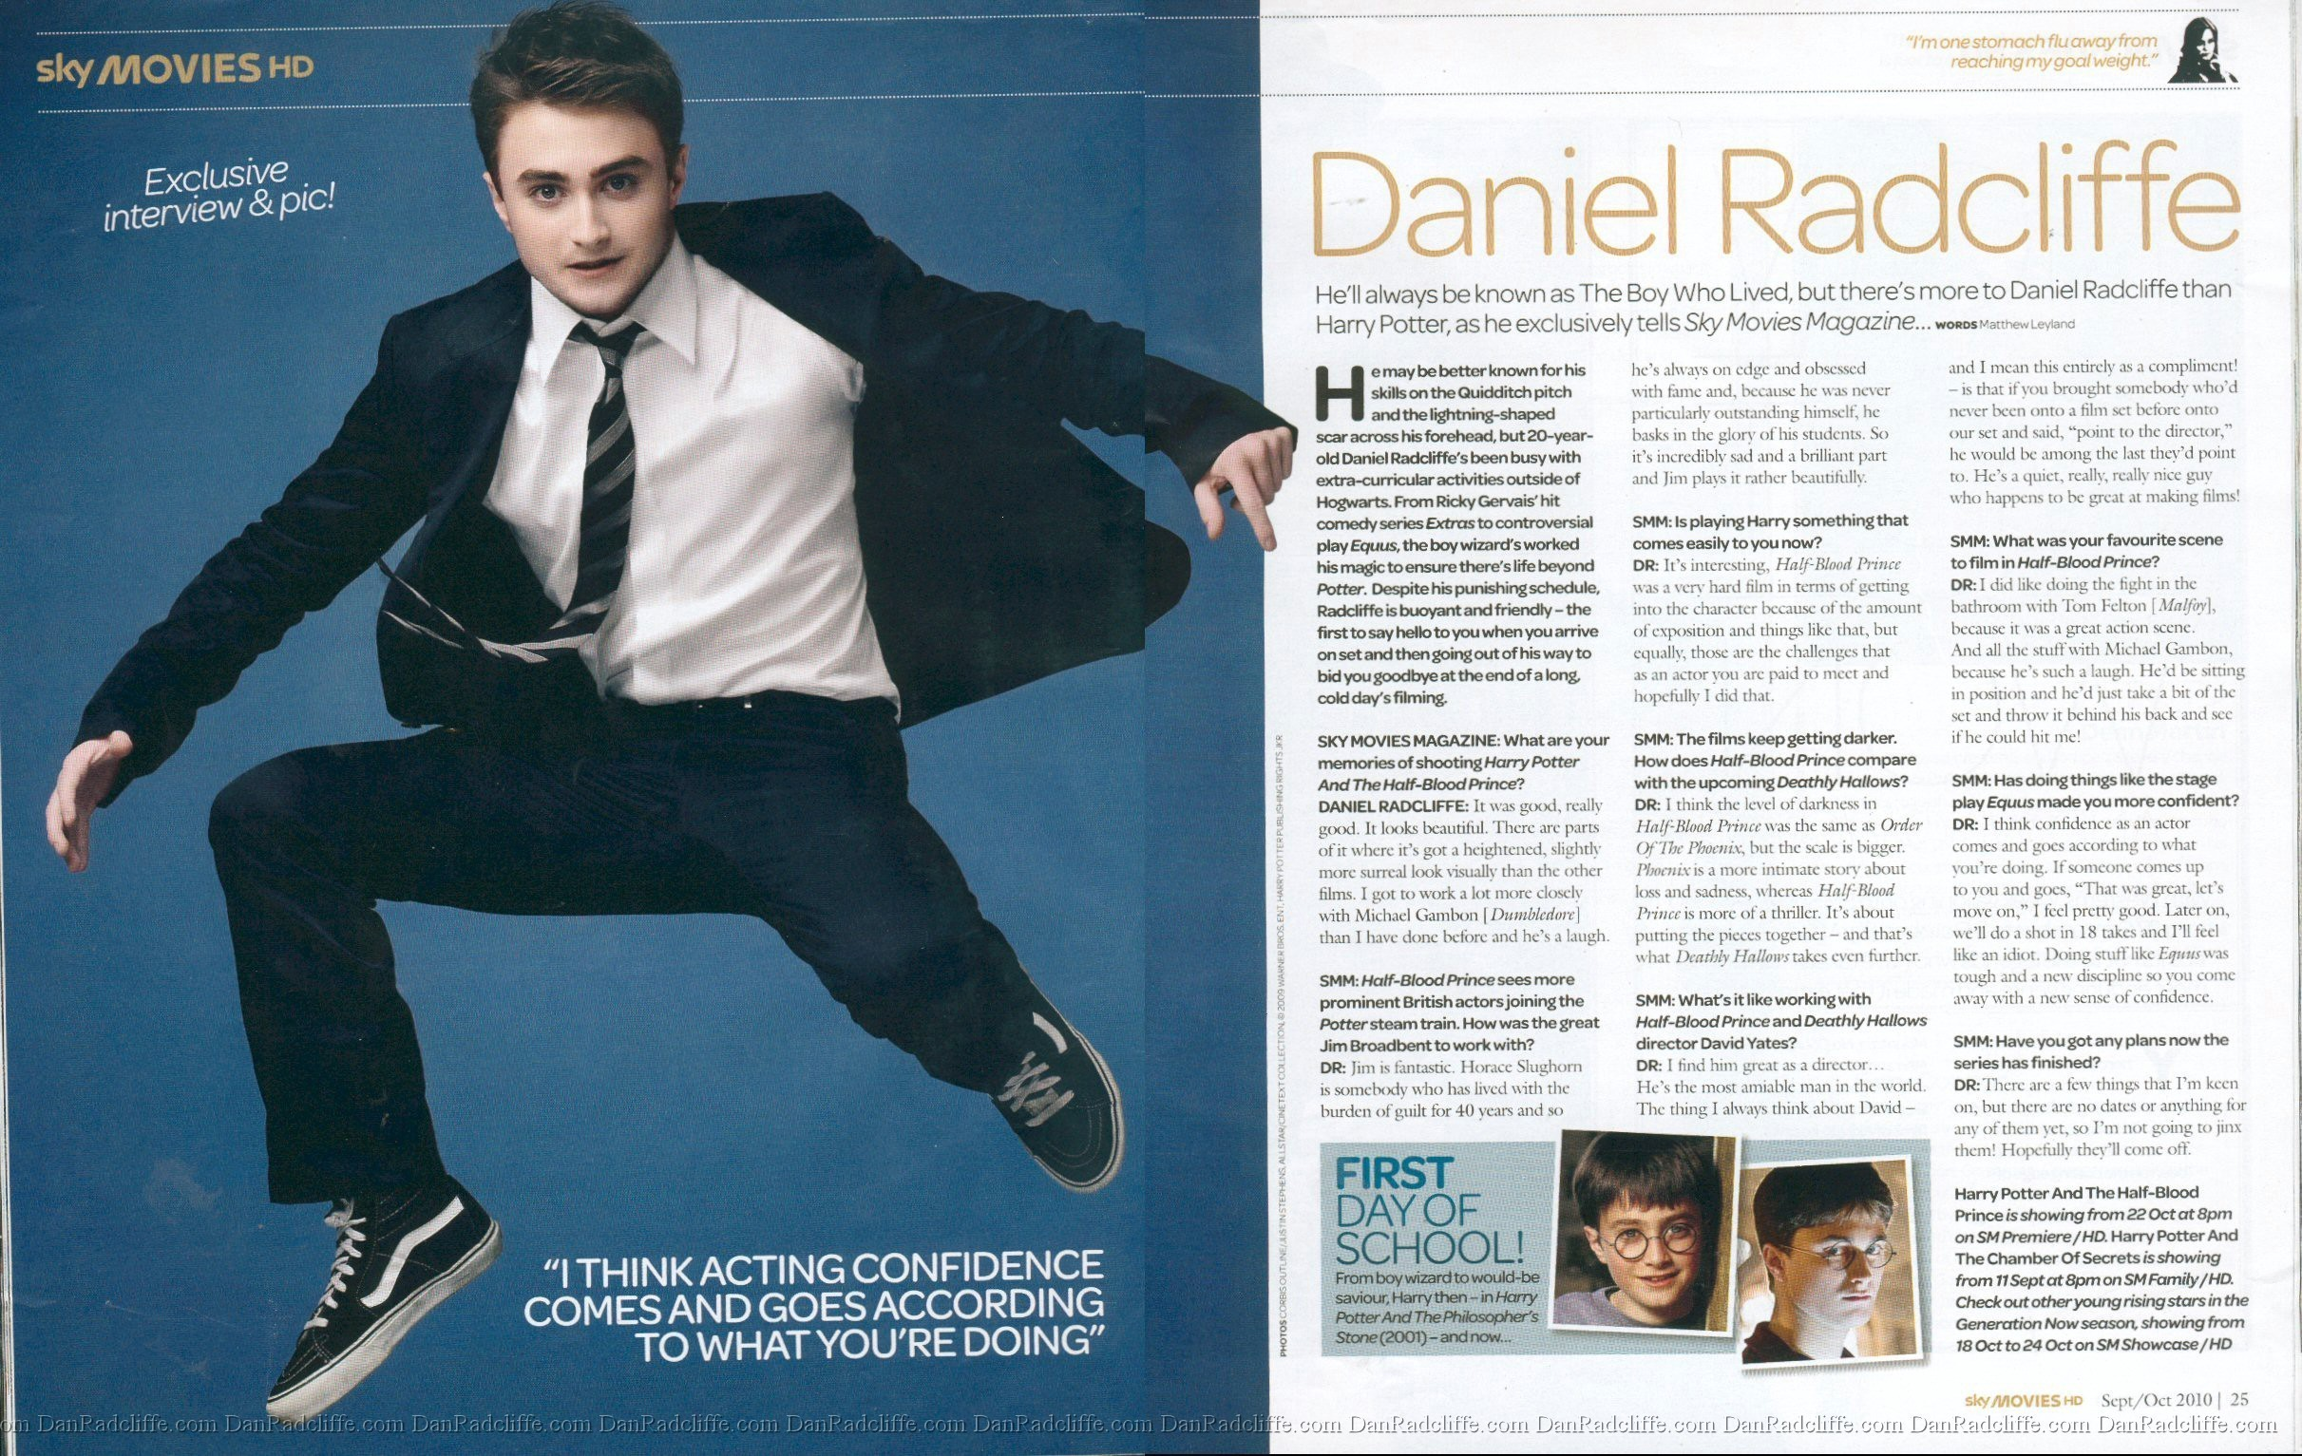

Slide 6
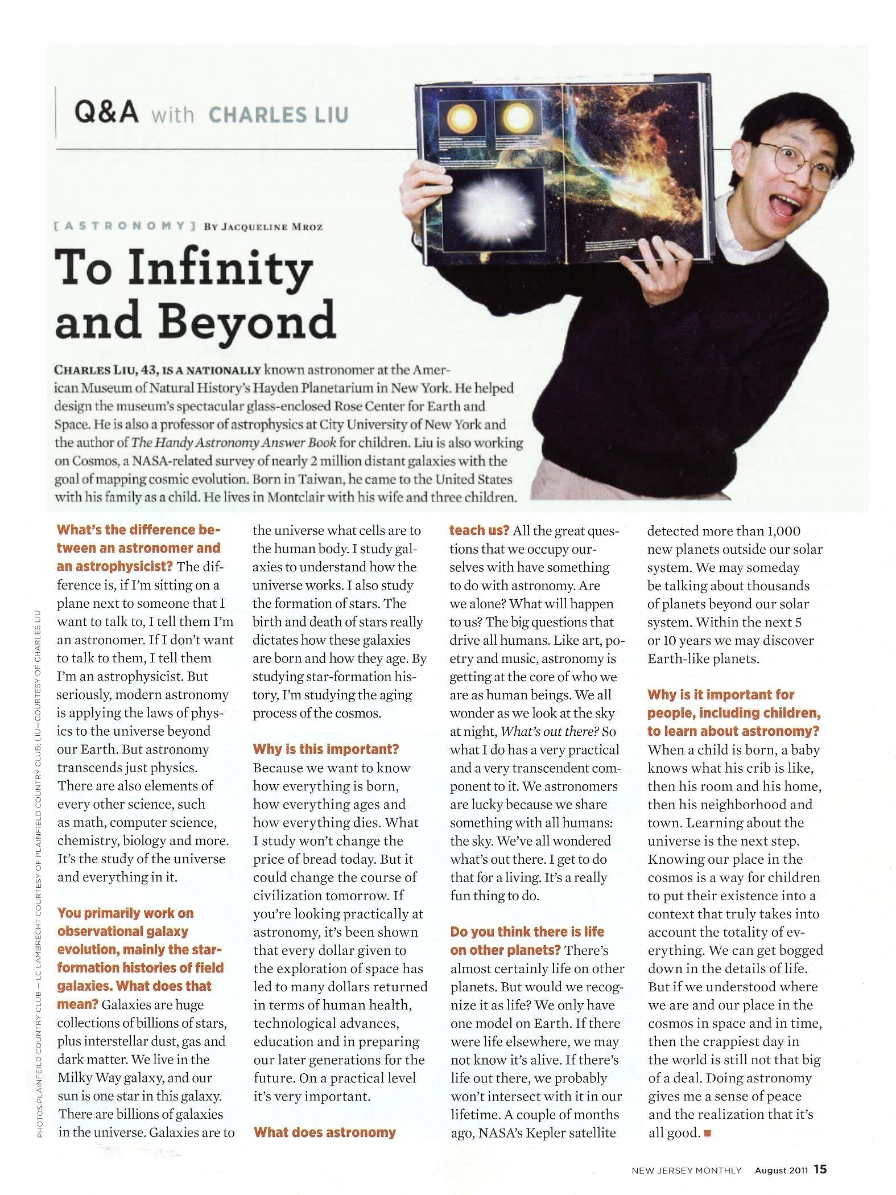

Slide 7
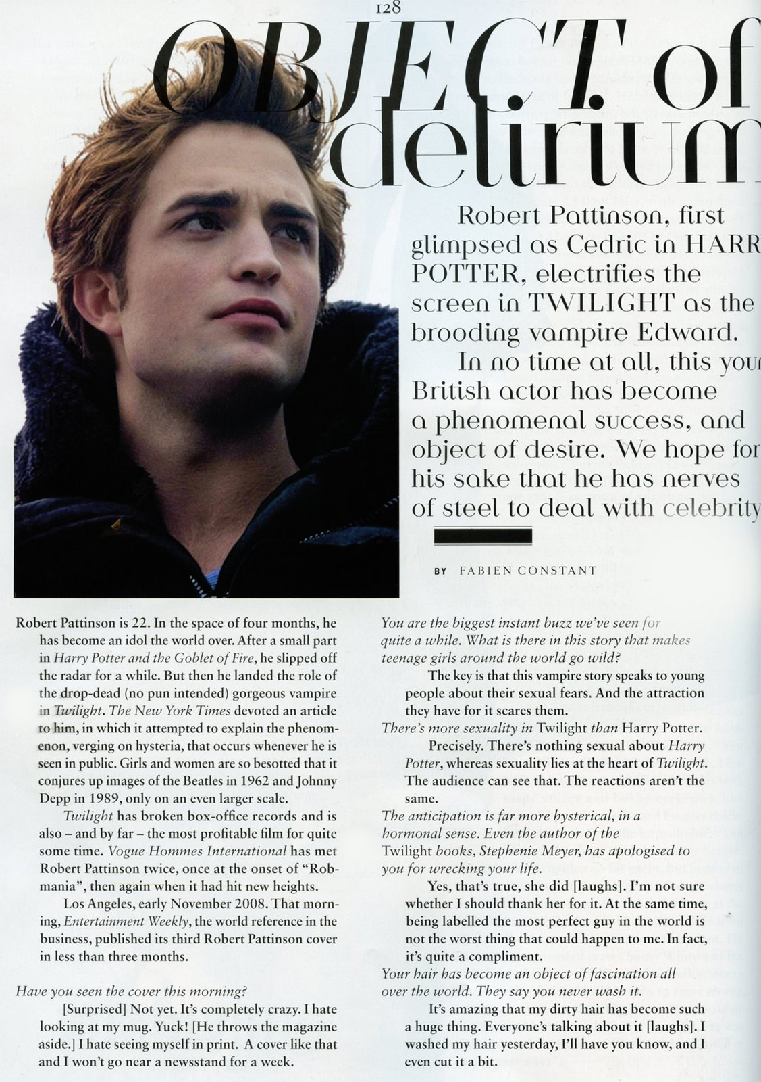

Slide 8
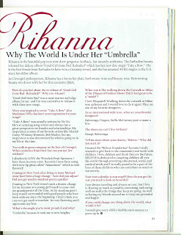

Slide 9
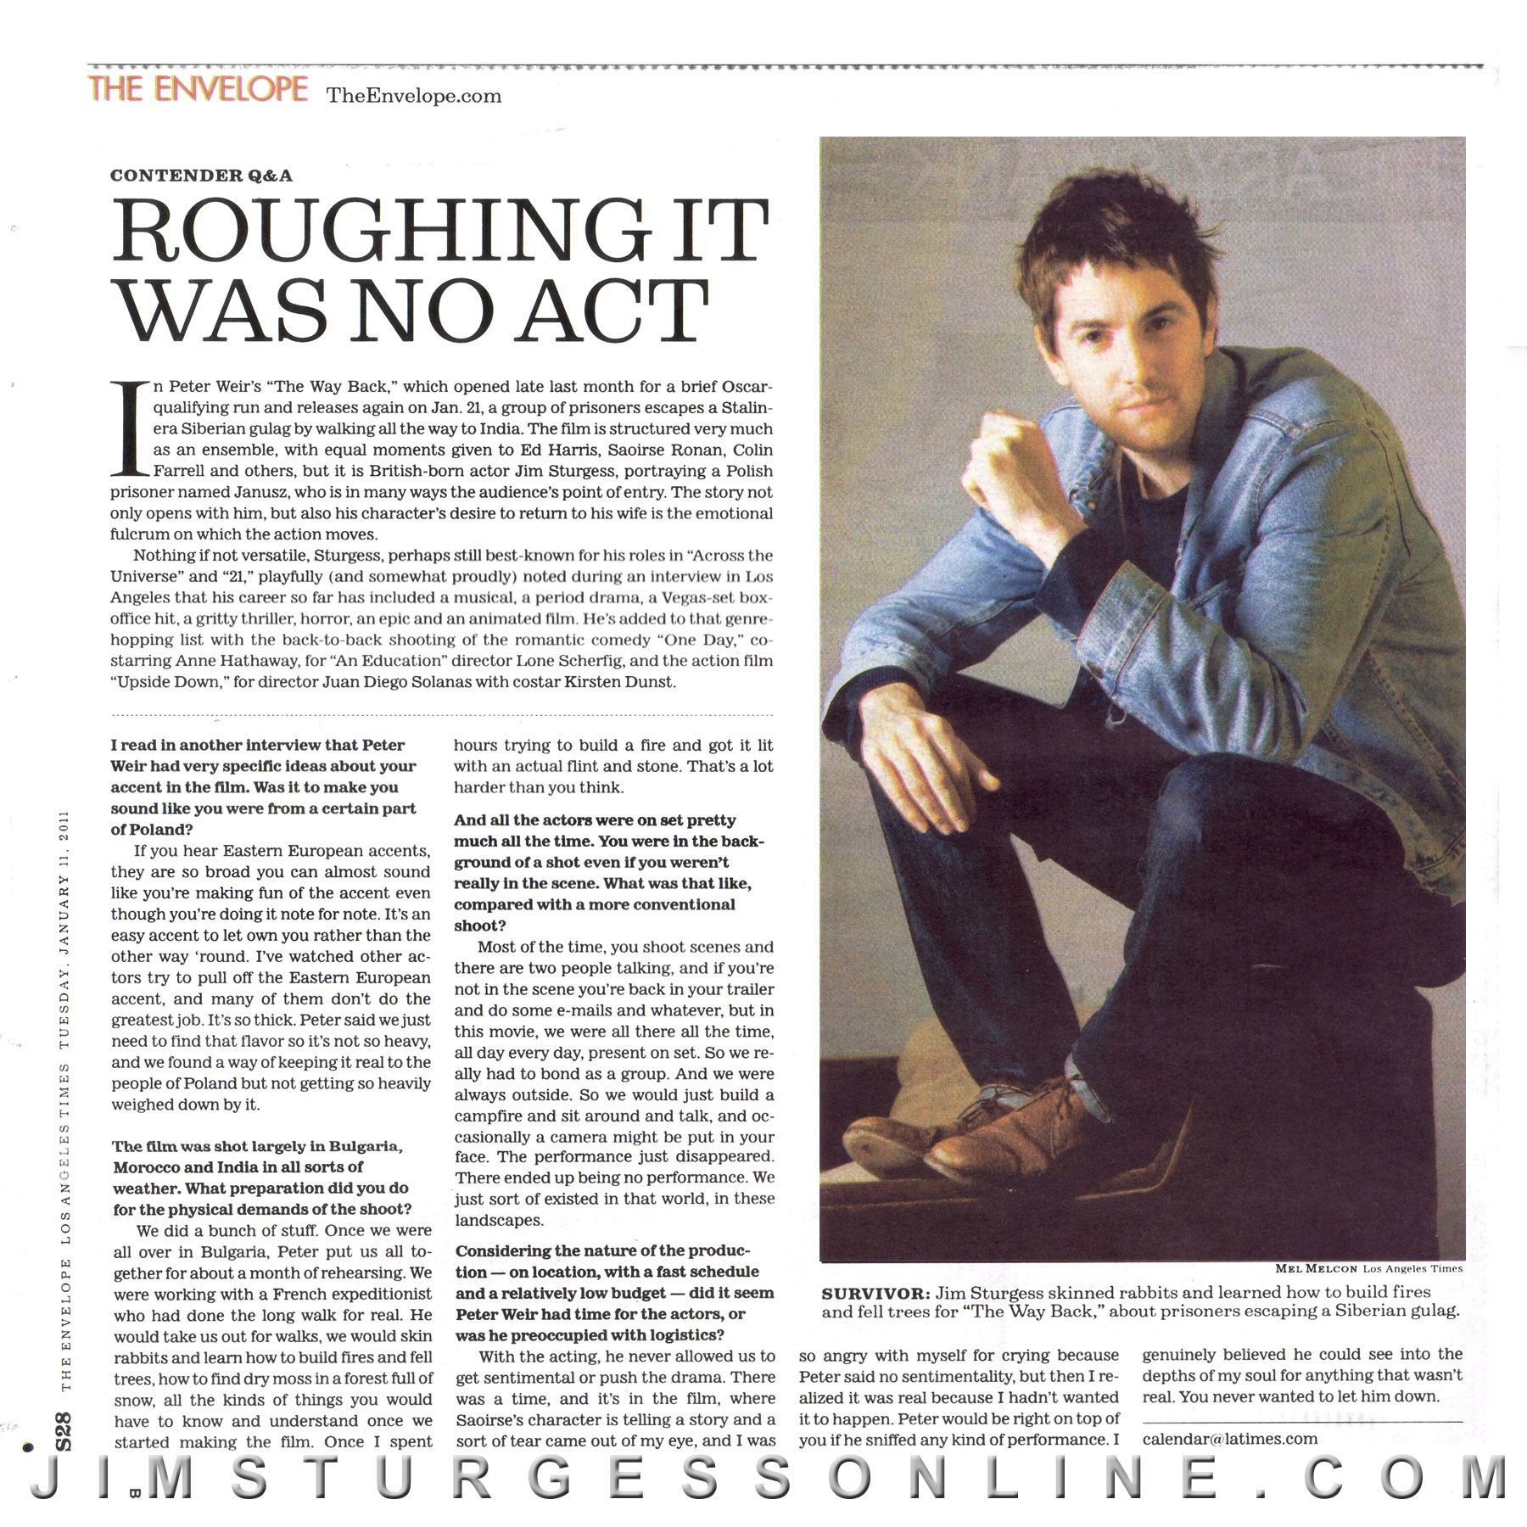

Slide 11
https://prezi.com/jugfiin01ouf/character-interview-of-scrooge/

