Slide 1
I can multiply fractions by fractions
30.11.20

Slide 4
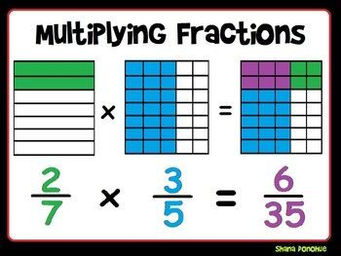
Now that you understand WHY, multiplying fractions is easy! Simply multiply the numerators together and then multiply the denominators together. Simplify your answer if possible.

Slide 5
Copy and complete. Write your answers in their simplest form

Slide 6
1/6 x 1/4
Possible answers…
2/3 x 3/4 = 6/12 = 1/2
2/2 x 3/6 = 6/12 = 1/2

Slide 7
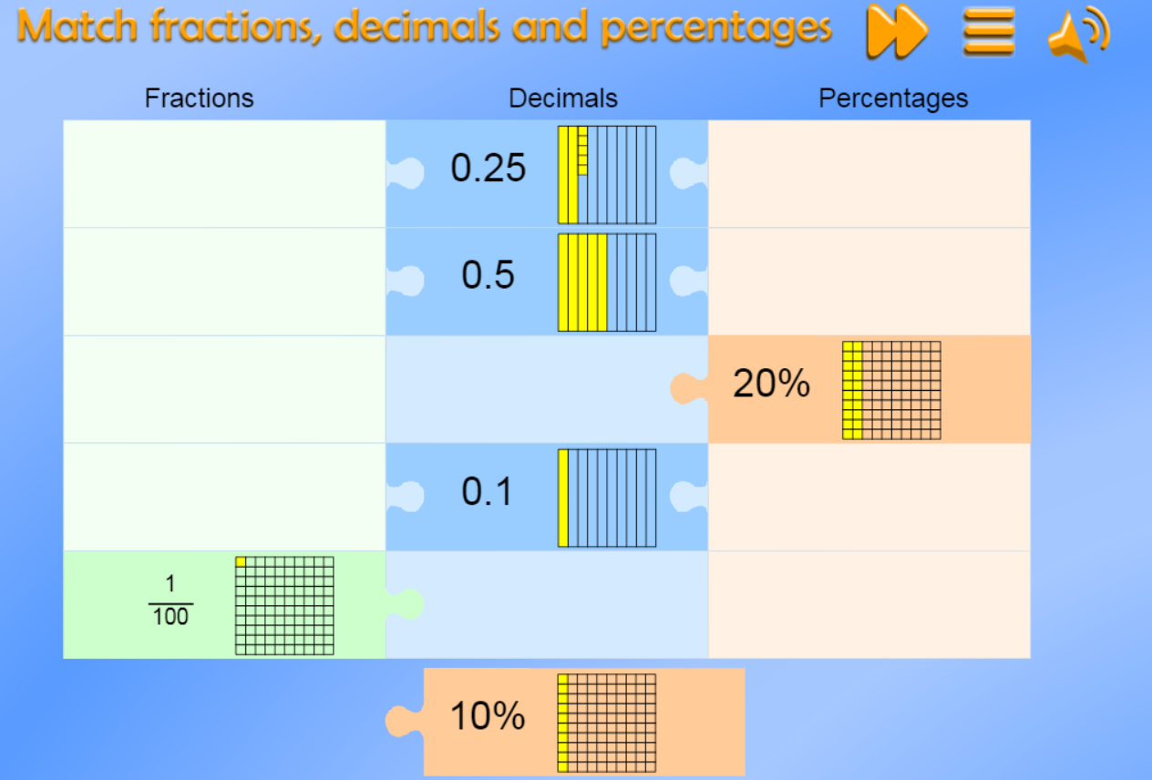
https://mathsframe.co.uk/en/resources/resource/120/match_fractions_decimals_and_percentages#.UCdcd2MsCEY

