Slide 1
I can subtract fractions
25.11.20

Slide 10
Were you correct?

Slide 11
Challenge!

Slide 12
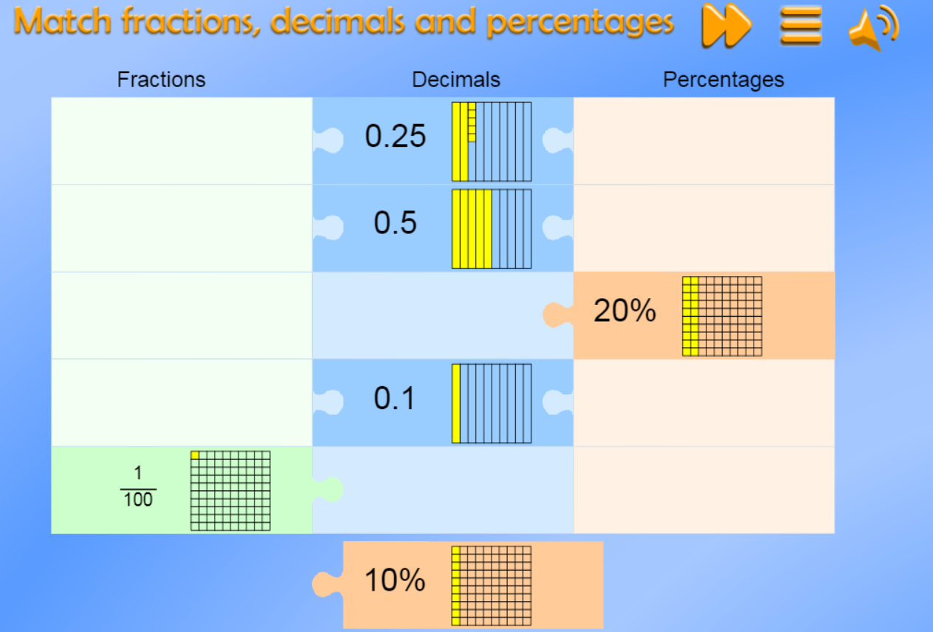
https://mathsframe.co.uk/en/resources/resource/120/match_fractions_decimals_and_percentages#.UCdcd2MsCEY

