Slide 1
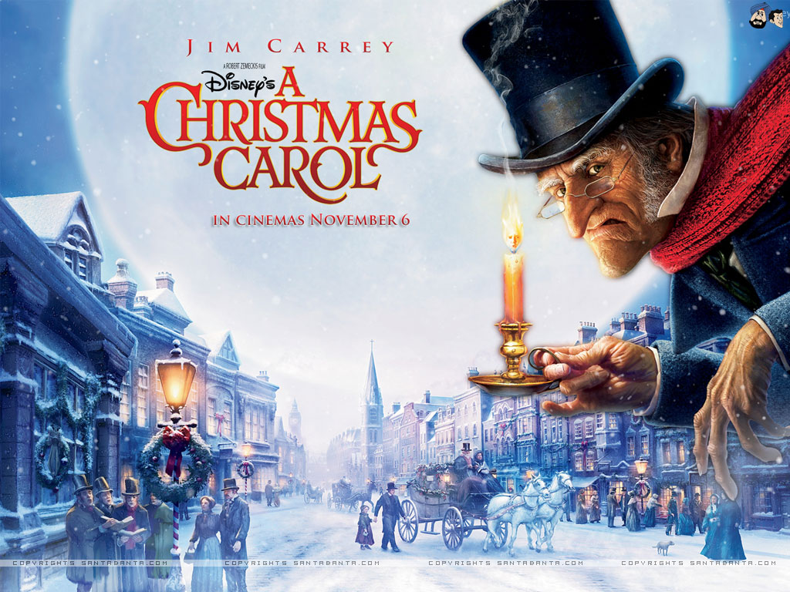
LO: apostrophes for omission and possession Wednesday 25th November 2020

Slide 7
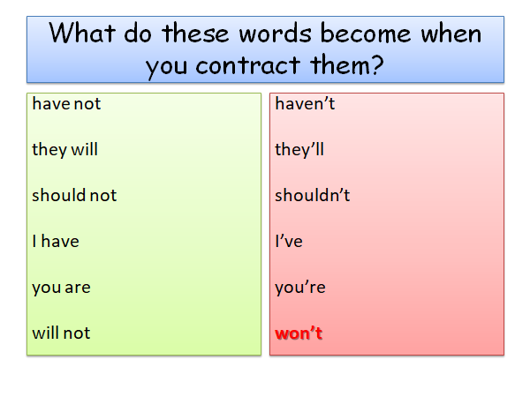

Slide 10
Apostrophes used for contraction (omission) | Apostrophes used for possession
Fill in the table with examples you can find in ‘A Christmas Carol.’ Write the example as a full sentence.

