Slide 1
I can subtract mixed numbers
24.11.20

Slide 4
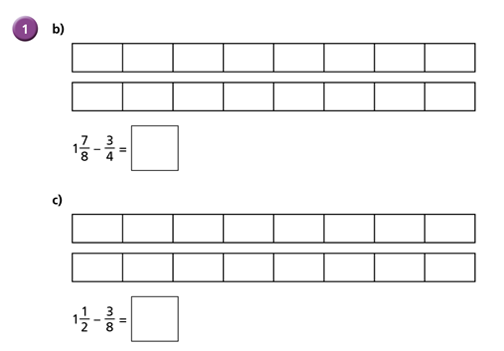

Slide 5
Dexter starts at ⅓ and counts on until he reaches 1 ⅚

Slide 6
Whitney also uses the ‘counting on’ method… but her ‘jumps’ are different. Whitney jumps to the nearest whole number first, whereas Dexter added a whole number first.

Slide 7
Remember to find a common denominator of both fractions first!

Slide 8
Now complete the rest of the worksheet. You can use any method you like!

Slide 9
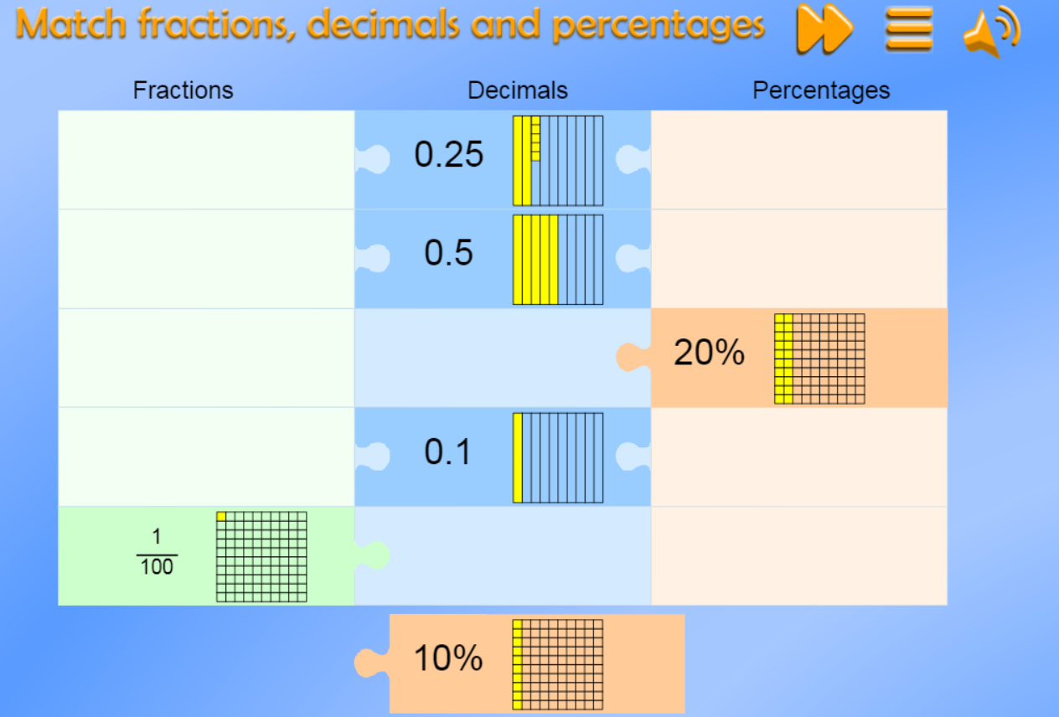
https://mathsframe.co.uk/en/resources/resource/120/match_fractions_decimals_and_percentages#.UCdcd2MsCEY

