Slide 1
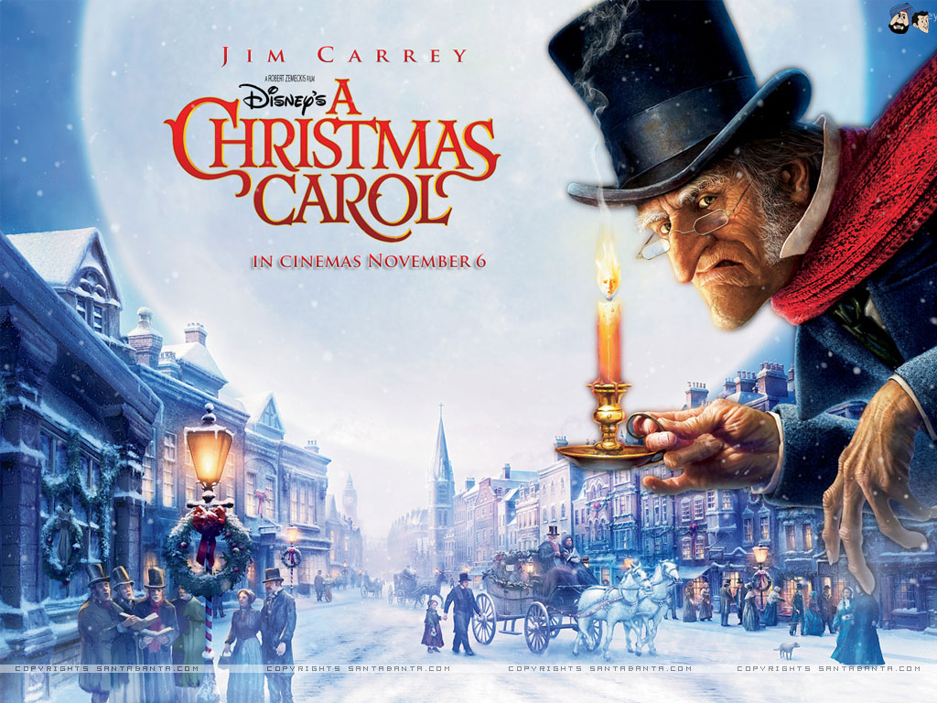
LO: formal writing and subjunctive form Tuesday 24th November 2020

Slide 7
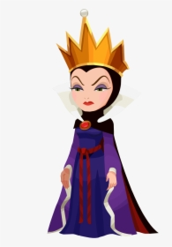

Slide 8
Identify the subjunctive...

Slide 9
Create a formal invitation to the Fezziwig Christmas Ball… can you incorporate the subjunctive?
What are the features of an invitation? What details or information must be included?

