Slide 1
I CAN GROUP LIVING THINGS IN A RANGE OF WAYS.
20.11.20

Slide 2
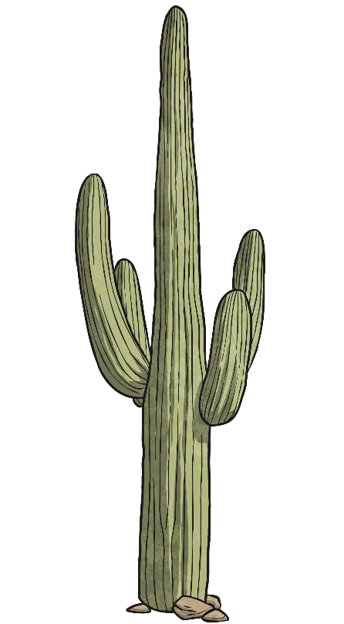
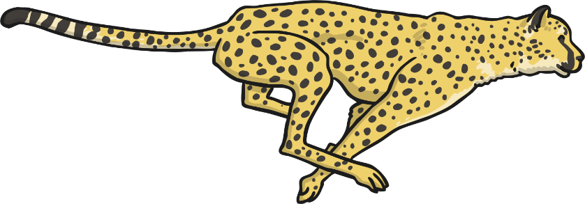
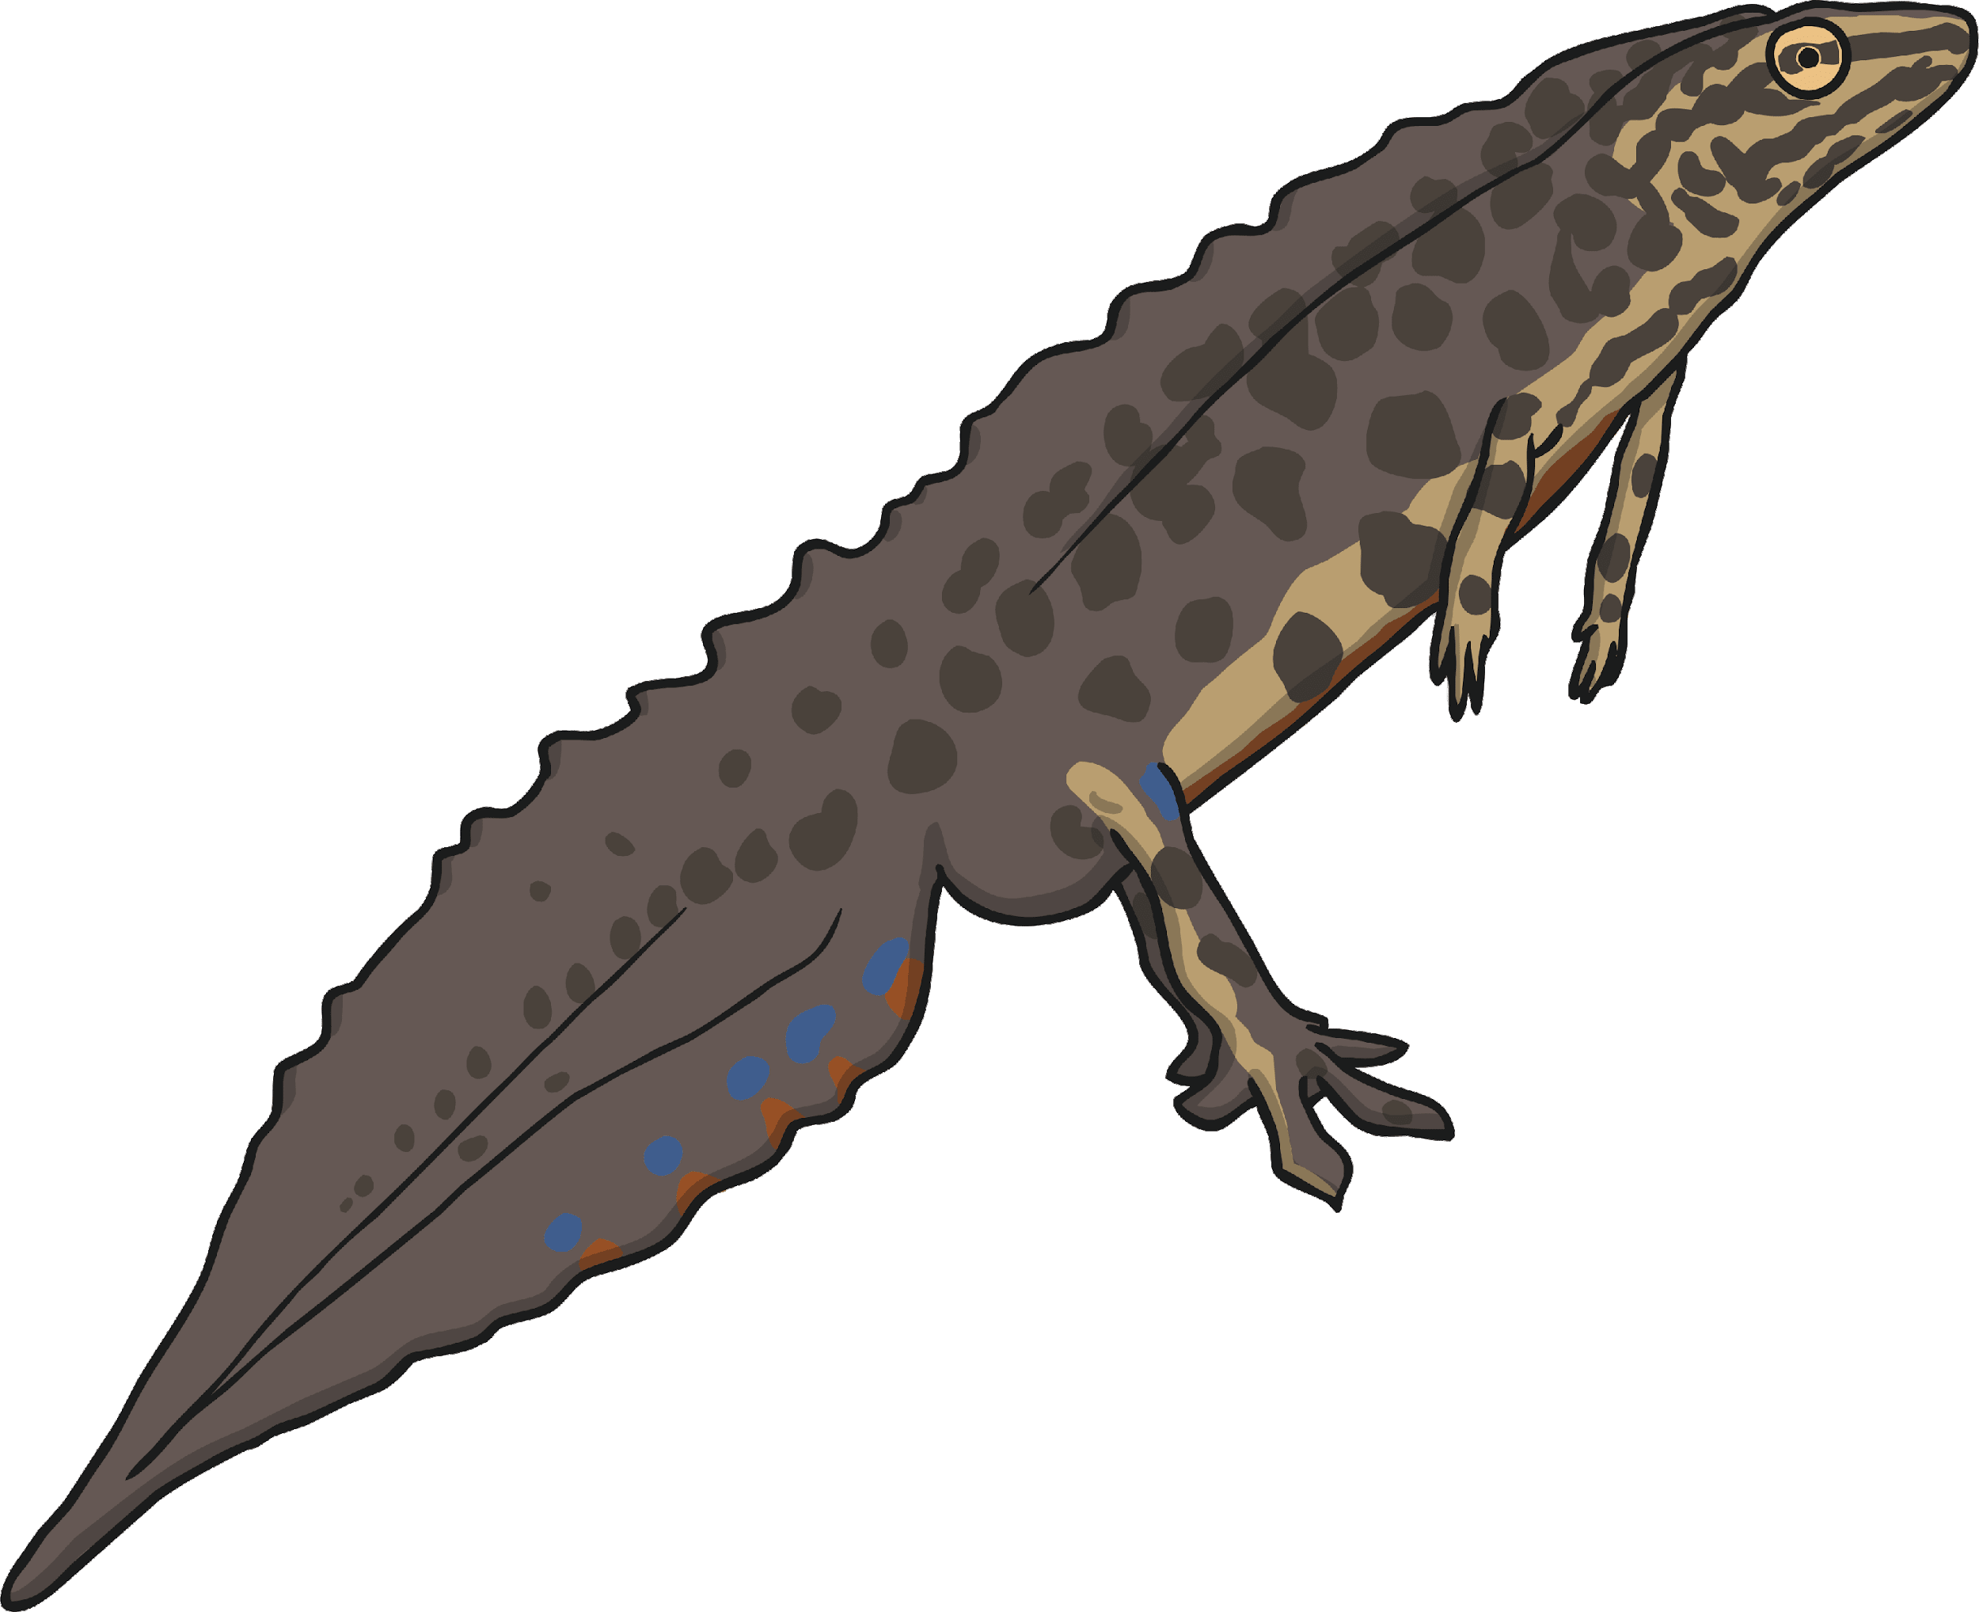
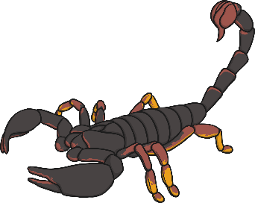
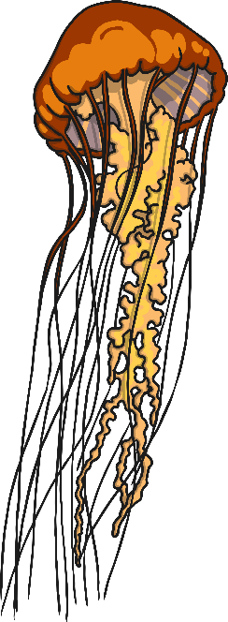
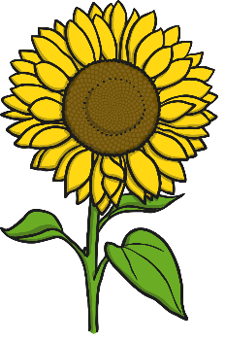
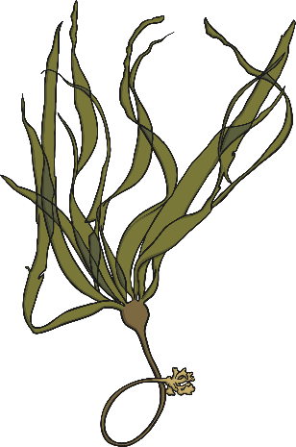
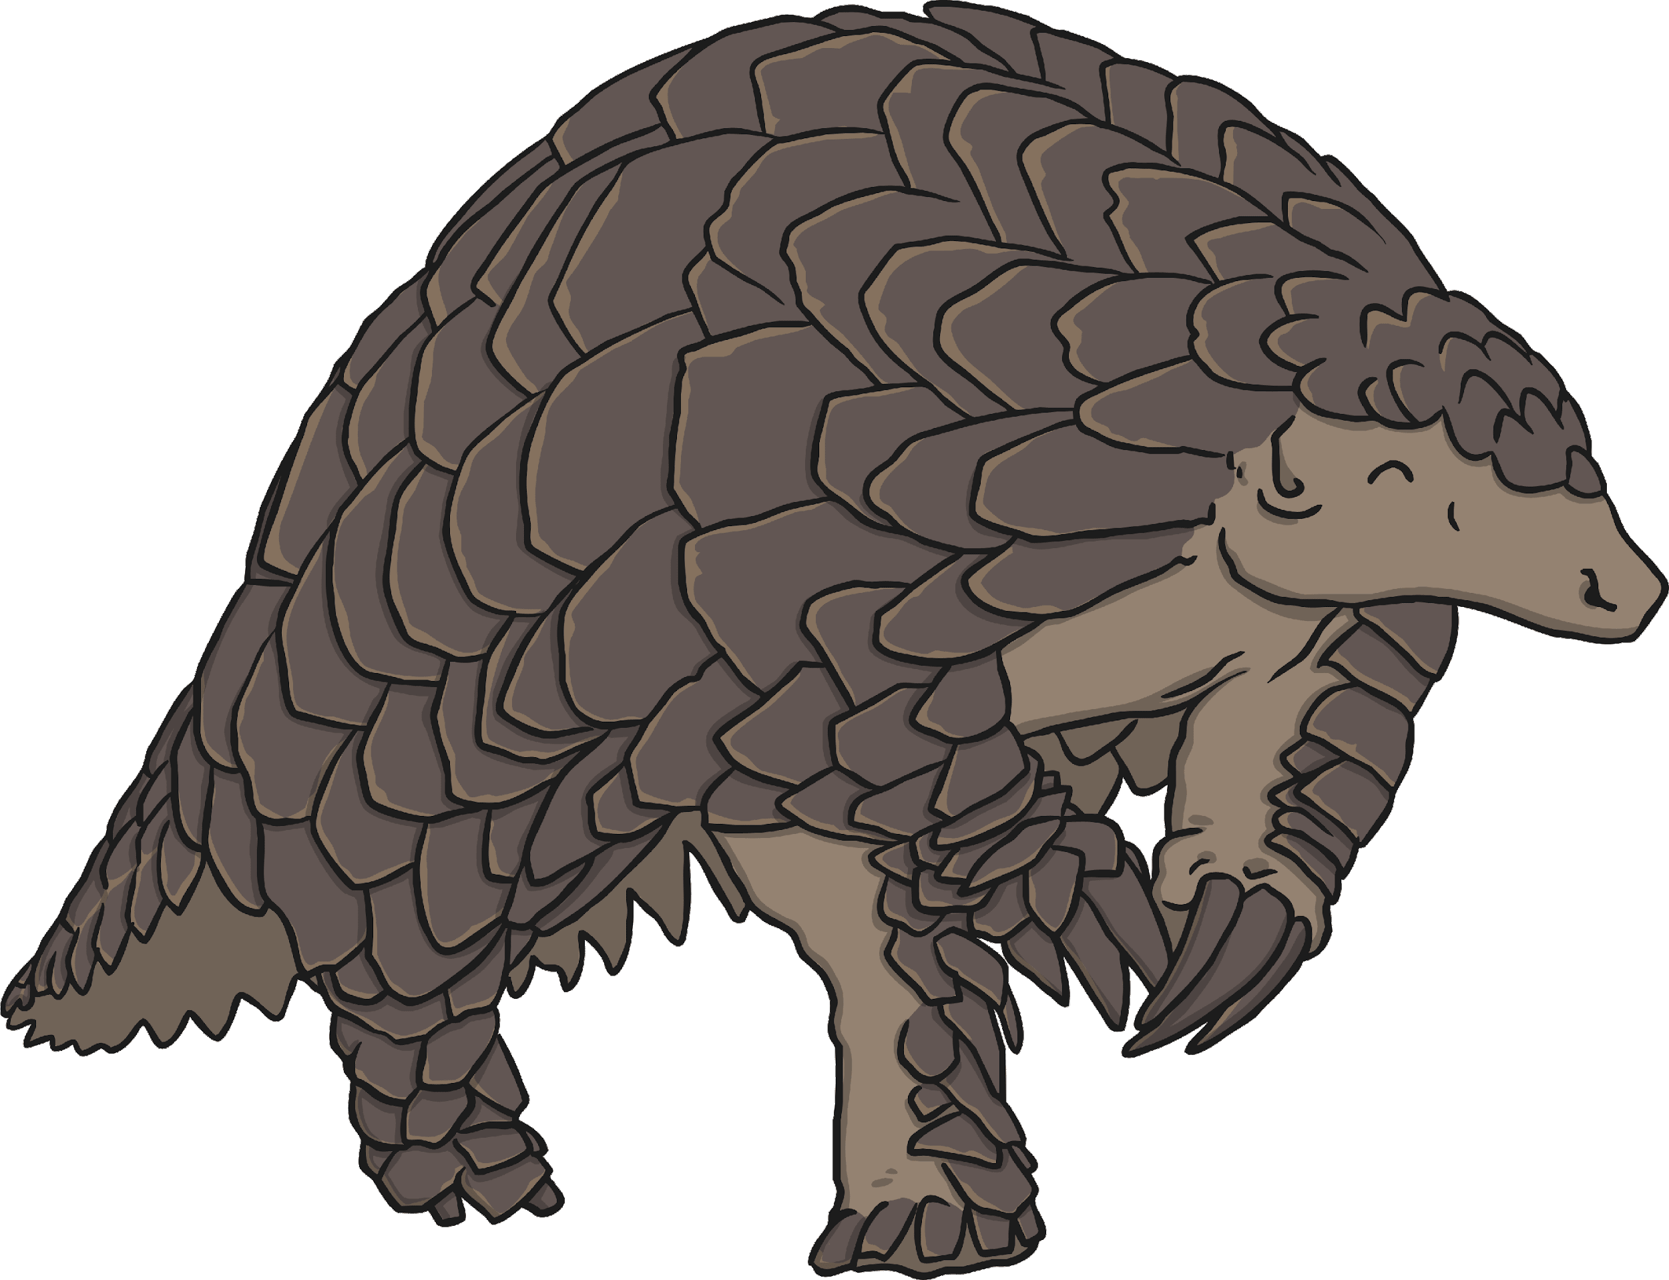
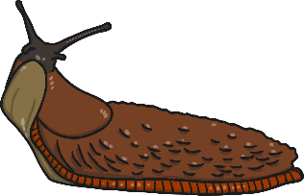
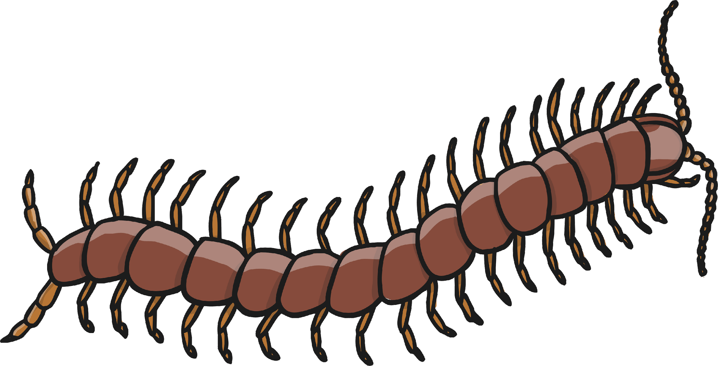
Life Processes
What do all these things have in common?
Notes:
I will begin by asking the children what all of these organisms have in common and I anticipate they will respond with that they are alive.

Slide 3
Life Processes
All of these images are of living things. Sometimes we call them ‘organisms’.
Even though they might be very different from each other, all of these organisms share certain characteristics. All living things do certain things to stay alive. These are called life processes.
All animals, including humans, do these things. Plants do too, although they do them in different ways.
We can remember life processes by thinking about Mrs Gren.
Notes:
I will now introduce the terms ‘life processes’ and ‘organisms’. We will have a brief discussion outlining what both of the term means and maybe asking the children to give some examples to solidify their understanding.

Slide 4
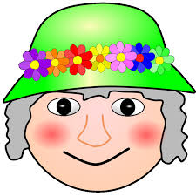
LET’S HAVE A LOOK AT MRS GREN AGAIN IN A LITTLE MORE DETAIL!
Can anyone remember what MRS GREN stands for?
Notes:
Now, I would like to recap’ MRS GREN’ from our previous lesson in a little more detail. I hope by sharing the further detail and examples, the children will be able to understand and then use this vocabulary in their learning and writing.

Slide 5
Life Processes
Movement
Respiration
Sensitivity
Growth
Reproduction
Excretion
Nutrition
MRS GREN

Slide 6
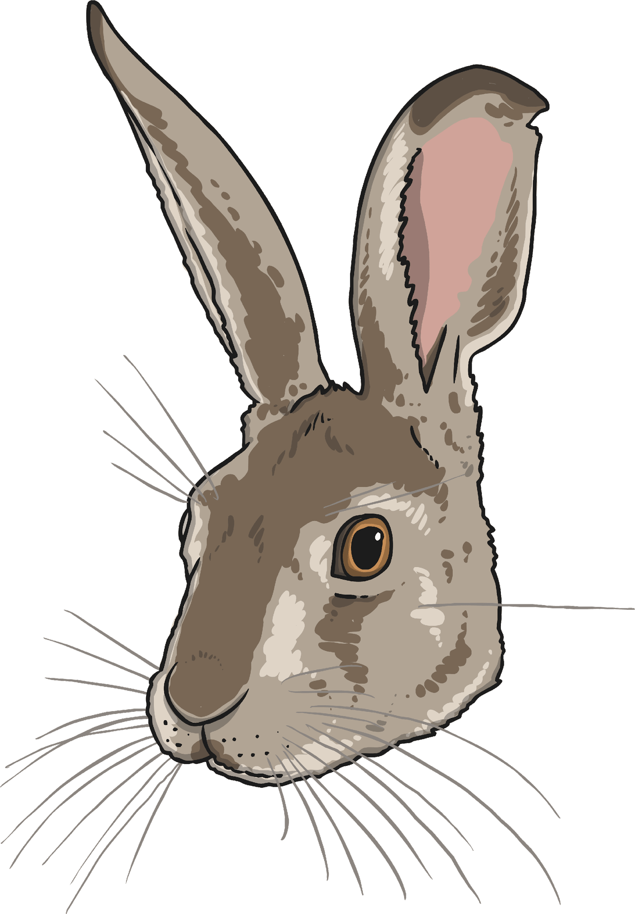
Life Processes
Movement
All living things move.
A hare runs to escape from danger.
Animals
move around
to get from
place to
place.
Plants grow and turn towards the light.
A sunflower moves to turn its face towards the sun.

Slide 7
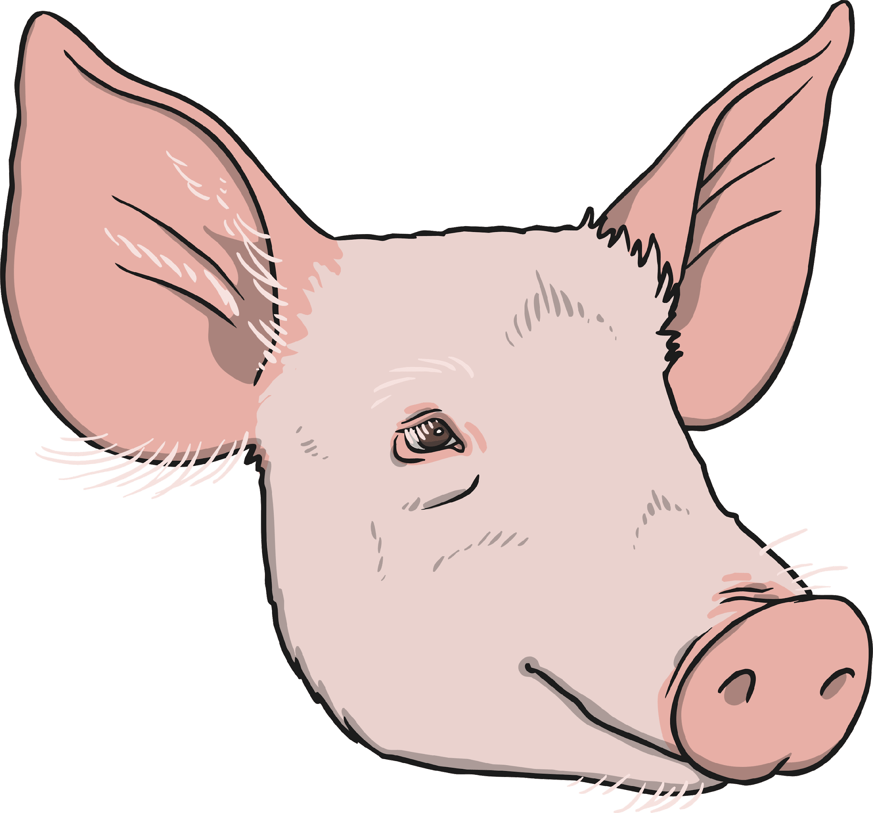
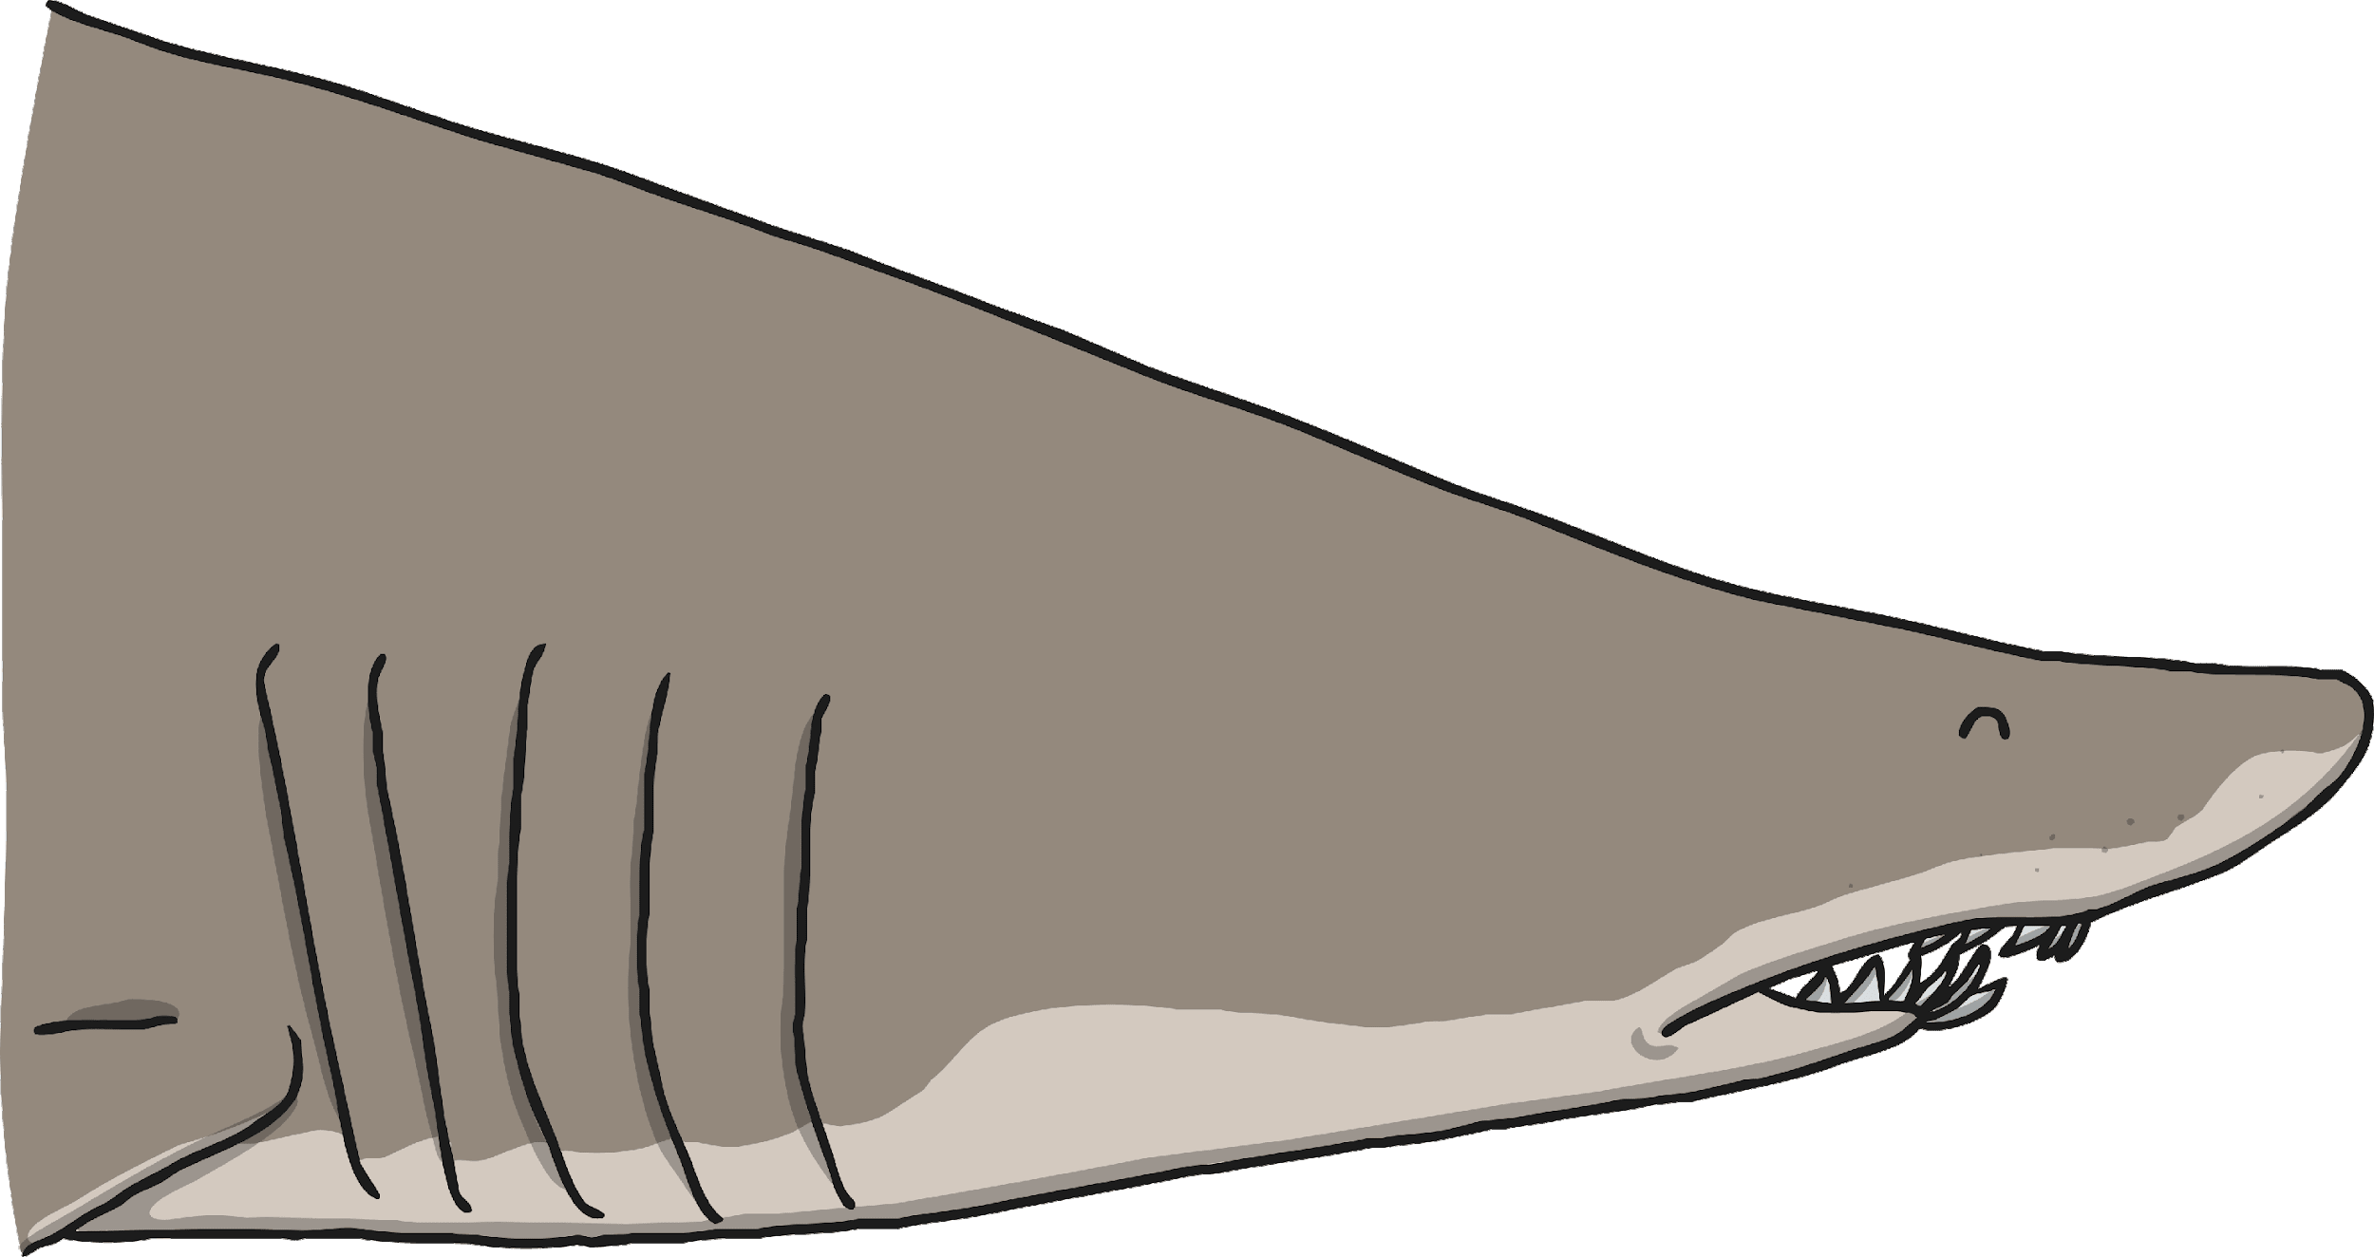
Life Processes
Respiration
Land animals breathe oxygen through their mouths or noses. Sea creatures breathe oxygen dissolved in the water through their gills. Both types of creature then use this oxygen in their
body for respiration.
All living things respire.
Plants and animals both use oxygen gas from the air to turn their food into energy. This is called respiration.
Plants both respire and photosynthesise. While photosynthesis happens when the plant is in light, plants respire by taking in oxygen and giving out carbon dioxide during darkness.

Slide 8
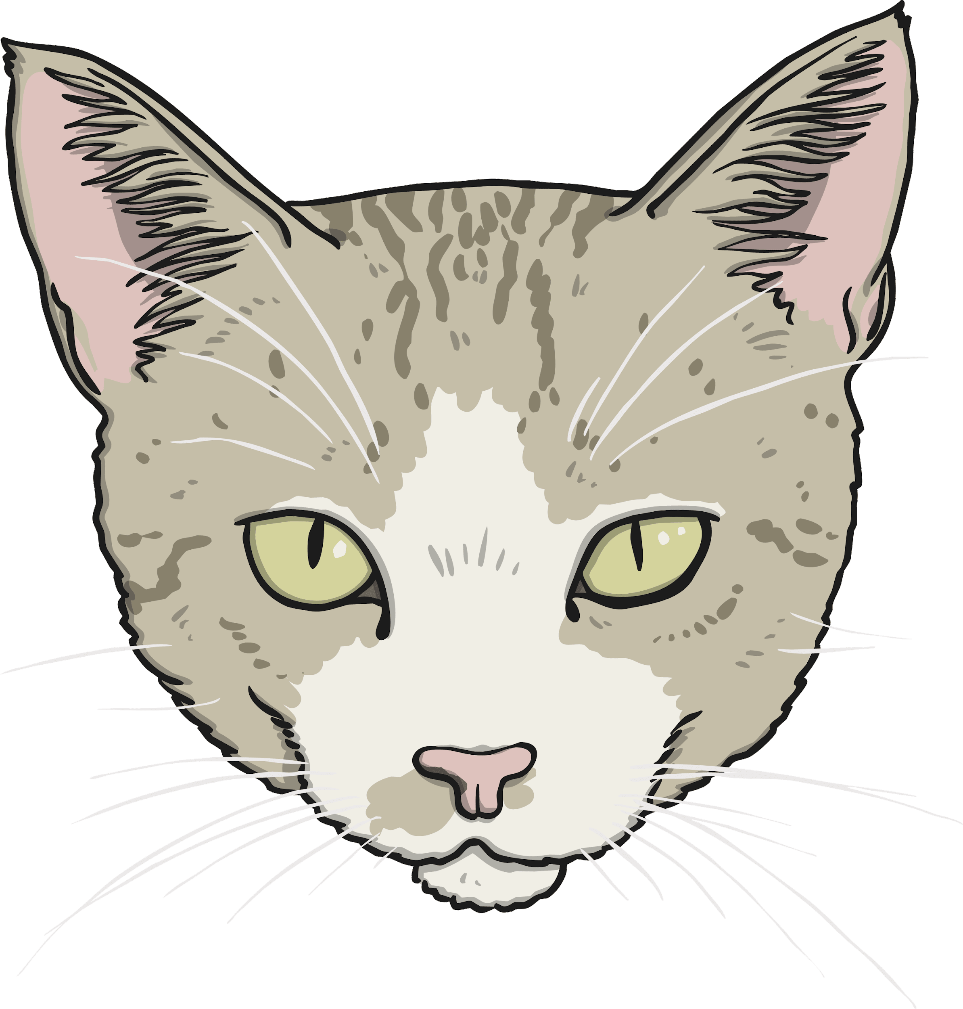
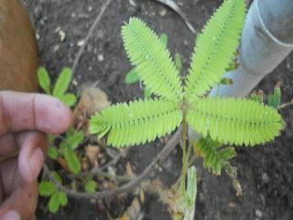
Life Processes
Sensitivity
Animals use their senses to see, hear, taste, touch and smell the world around them.
All living things are sensitive.
Every living thing can detect changes in their surroundings.
Plants can also detect changes in the environment. This mimosa plant curls up when you touch it!

Slide 9
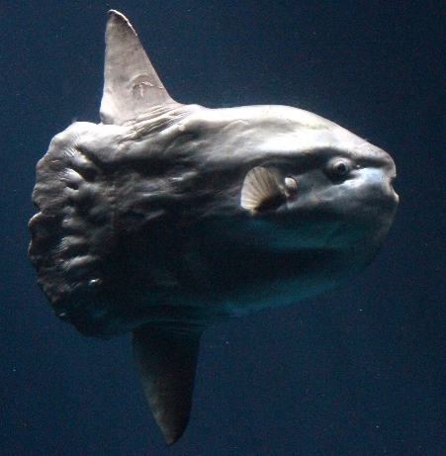
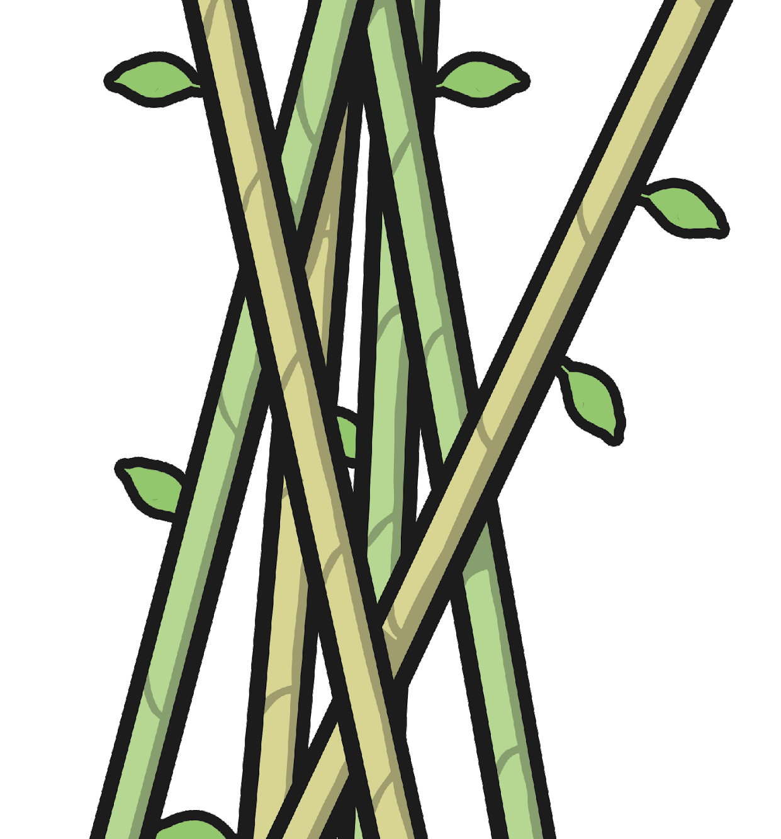
Life Processes
Growth
This ocean mola started life as an egg not much bigger than a full stop. It will grow to weigh about 1000 kg - this is the same size as a large bull!
All living things grow.
Animals grow from babies to adults.
Seeds grow into plants.
Bamboo can grow up to 3cm every hour.
Photo courtesy of sandipb (@flickr.com) - granted under creative commons licence - attribution

Slide 10
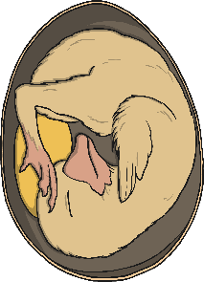
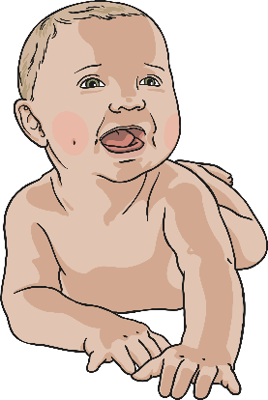
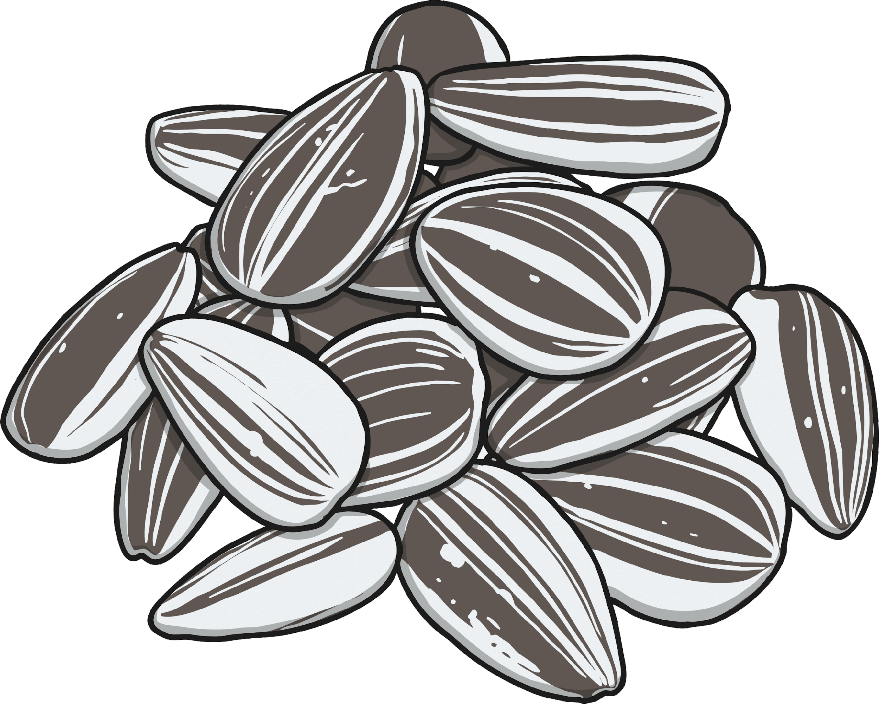
Life Processes
Reproduction
All living things reproduce.
Animals lay eggs or give birth to live young.
Animals have young.
Plants
produce seeds from which more plants grow.
Most plants reproduce by forming seeds.

Slide 11
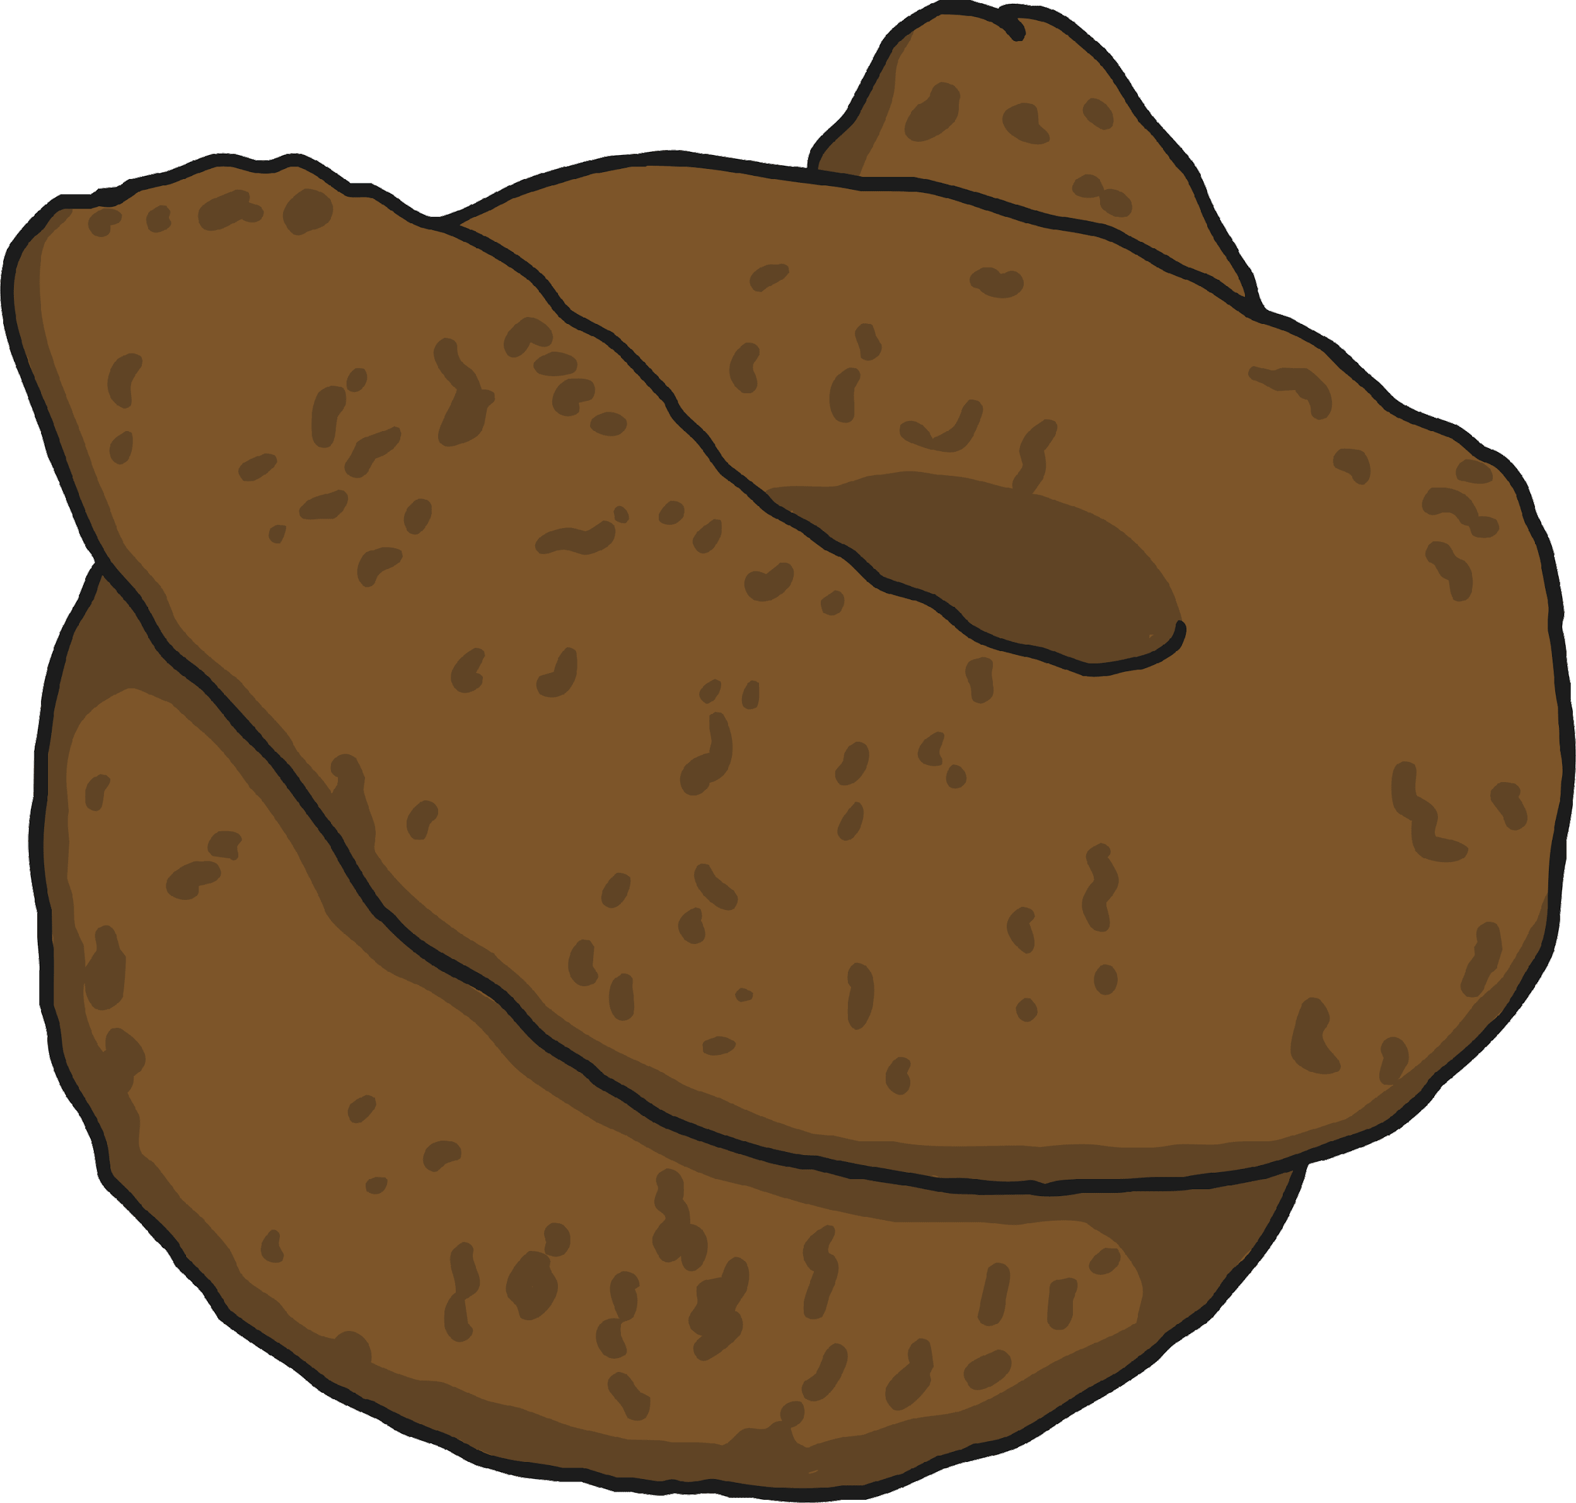
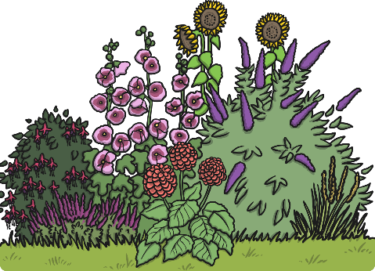
Life Processes
Excretion
All living things excrete.
Animals excrete waste through urine and faeces.
Waste products are removed from the body.
Both plants and animals have to get rid of excess gas and water.
Leftover gases and water leave plants from their leaves.

Slide 12
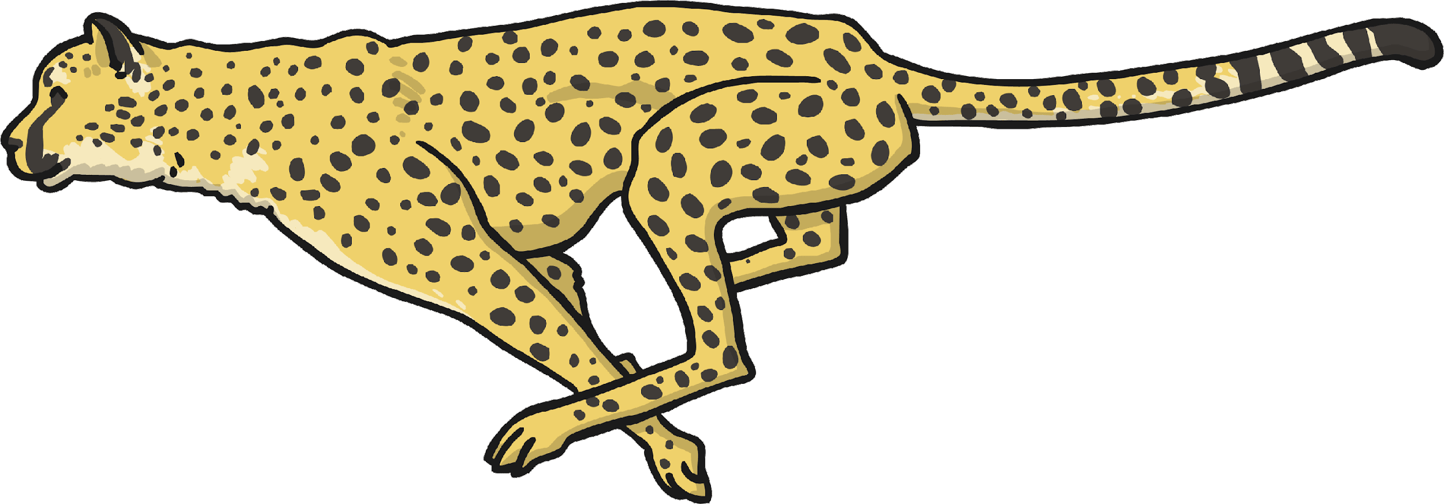
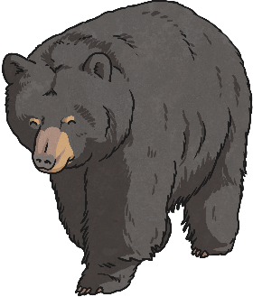
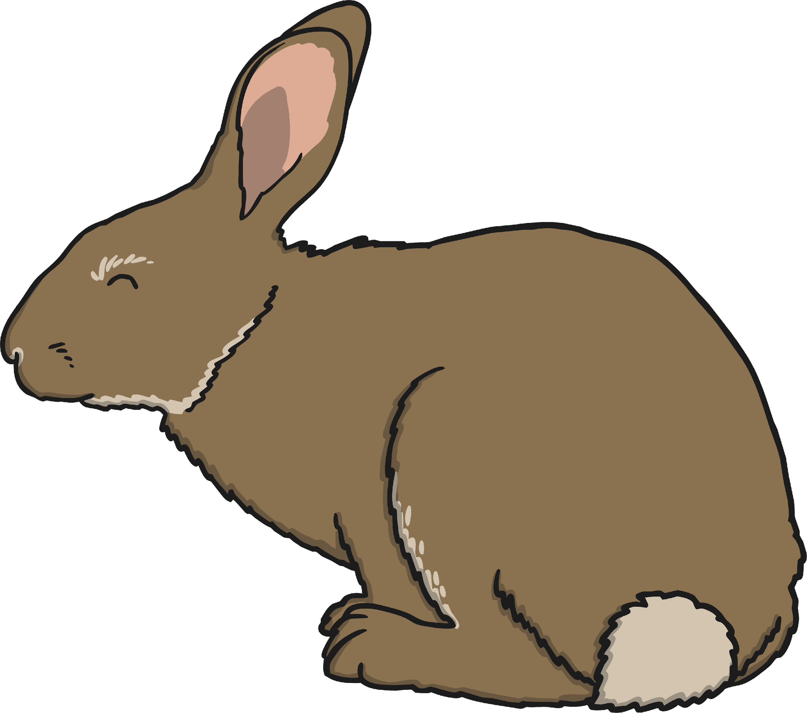
Life Processes
Nutrition
All living things need nutrition.
Animals may be carnivores, herbivores or omnivores.
Food is eaten to provide energy to live.
Green plants make their own food using sunlight.
Green plants make their own food using the energy from the sun.

Slide 13
Life Processes
All living organisms share these characteristics as part of MRS GREN. This is how we know they are alive!
Living things have lots of other similarities, and many differences too. We can use these similarities and differences to sort the living things into groups.

Slide 14
Grouping Living Things
With a partner, think of a way we could sort these organisms into two groups.
Notes:
I will now show a picture to the class which is lot’s of living things. I will ask the children to discuss with their partners some possible ways to group these living organisms. I want to ensure I use the correct vocabulary throughout the lesson to promote children to use this vocabulary too.

Slide 15
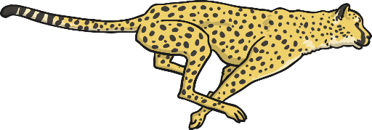
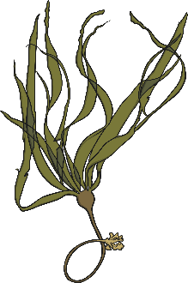
Grouping Living Things
Here, an organism cannot be both an animal and a plant, so it can not be in both groups at the same time.
Here the organisms have been sorted into two groups. We have used a diagram to represent these groups.
Can an organism be in both groups at the same time?
plants
animals

Slide 16
Herbivores, Carnivores and Omnivores.
Notes:
We will now move onto grouping herbivores, carnivores and omnivores. Explaining and understanding there different characteristics with the use of some helpful tips to remember the different classifications.

Slide 17
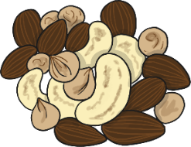
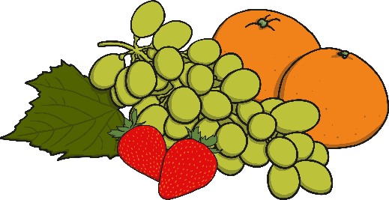
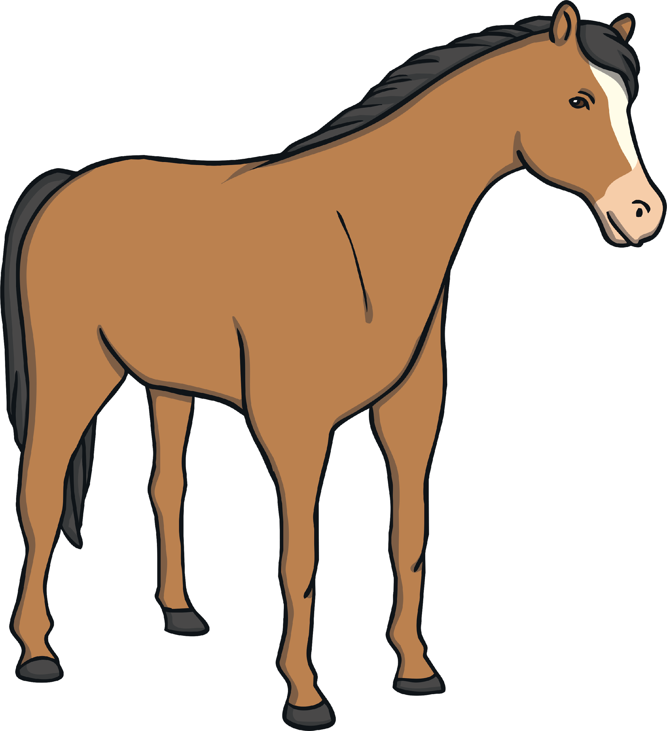
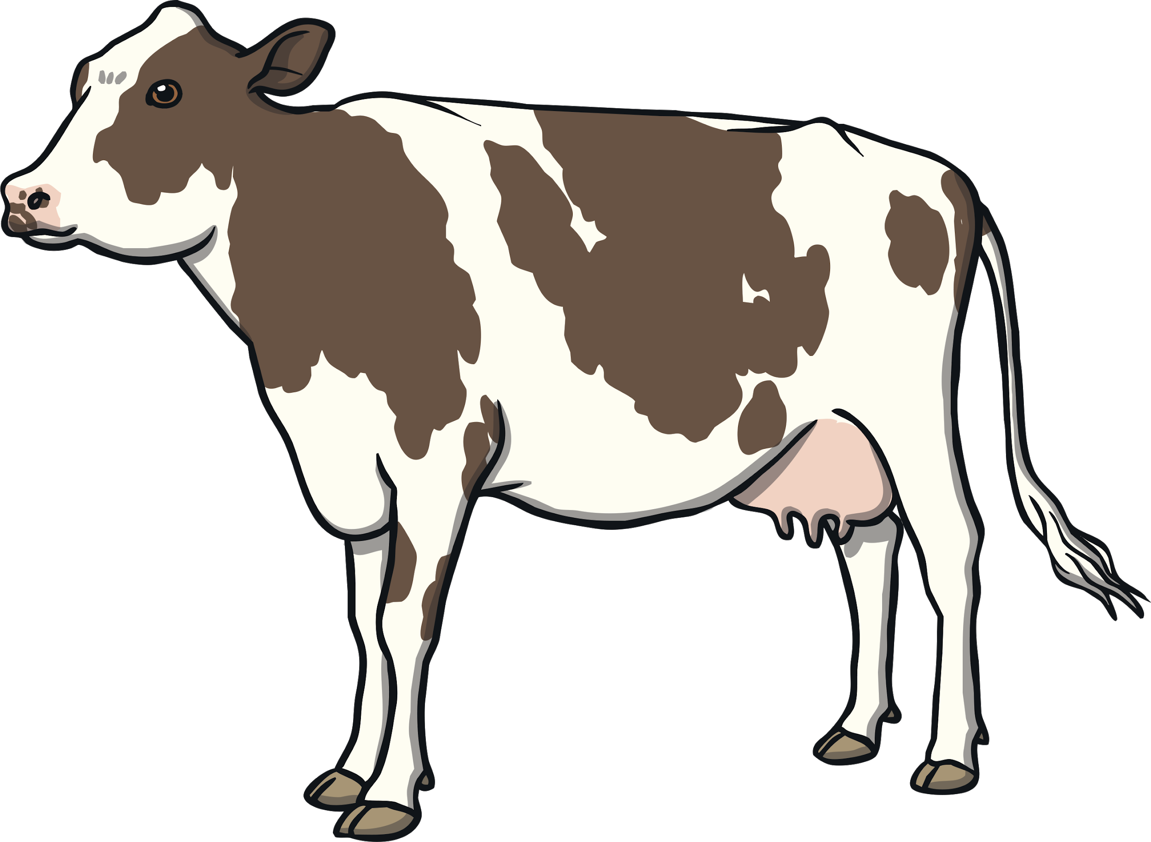
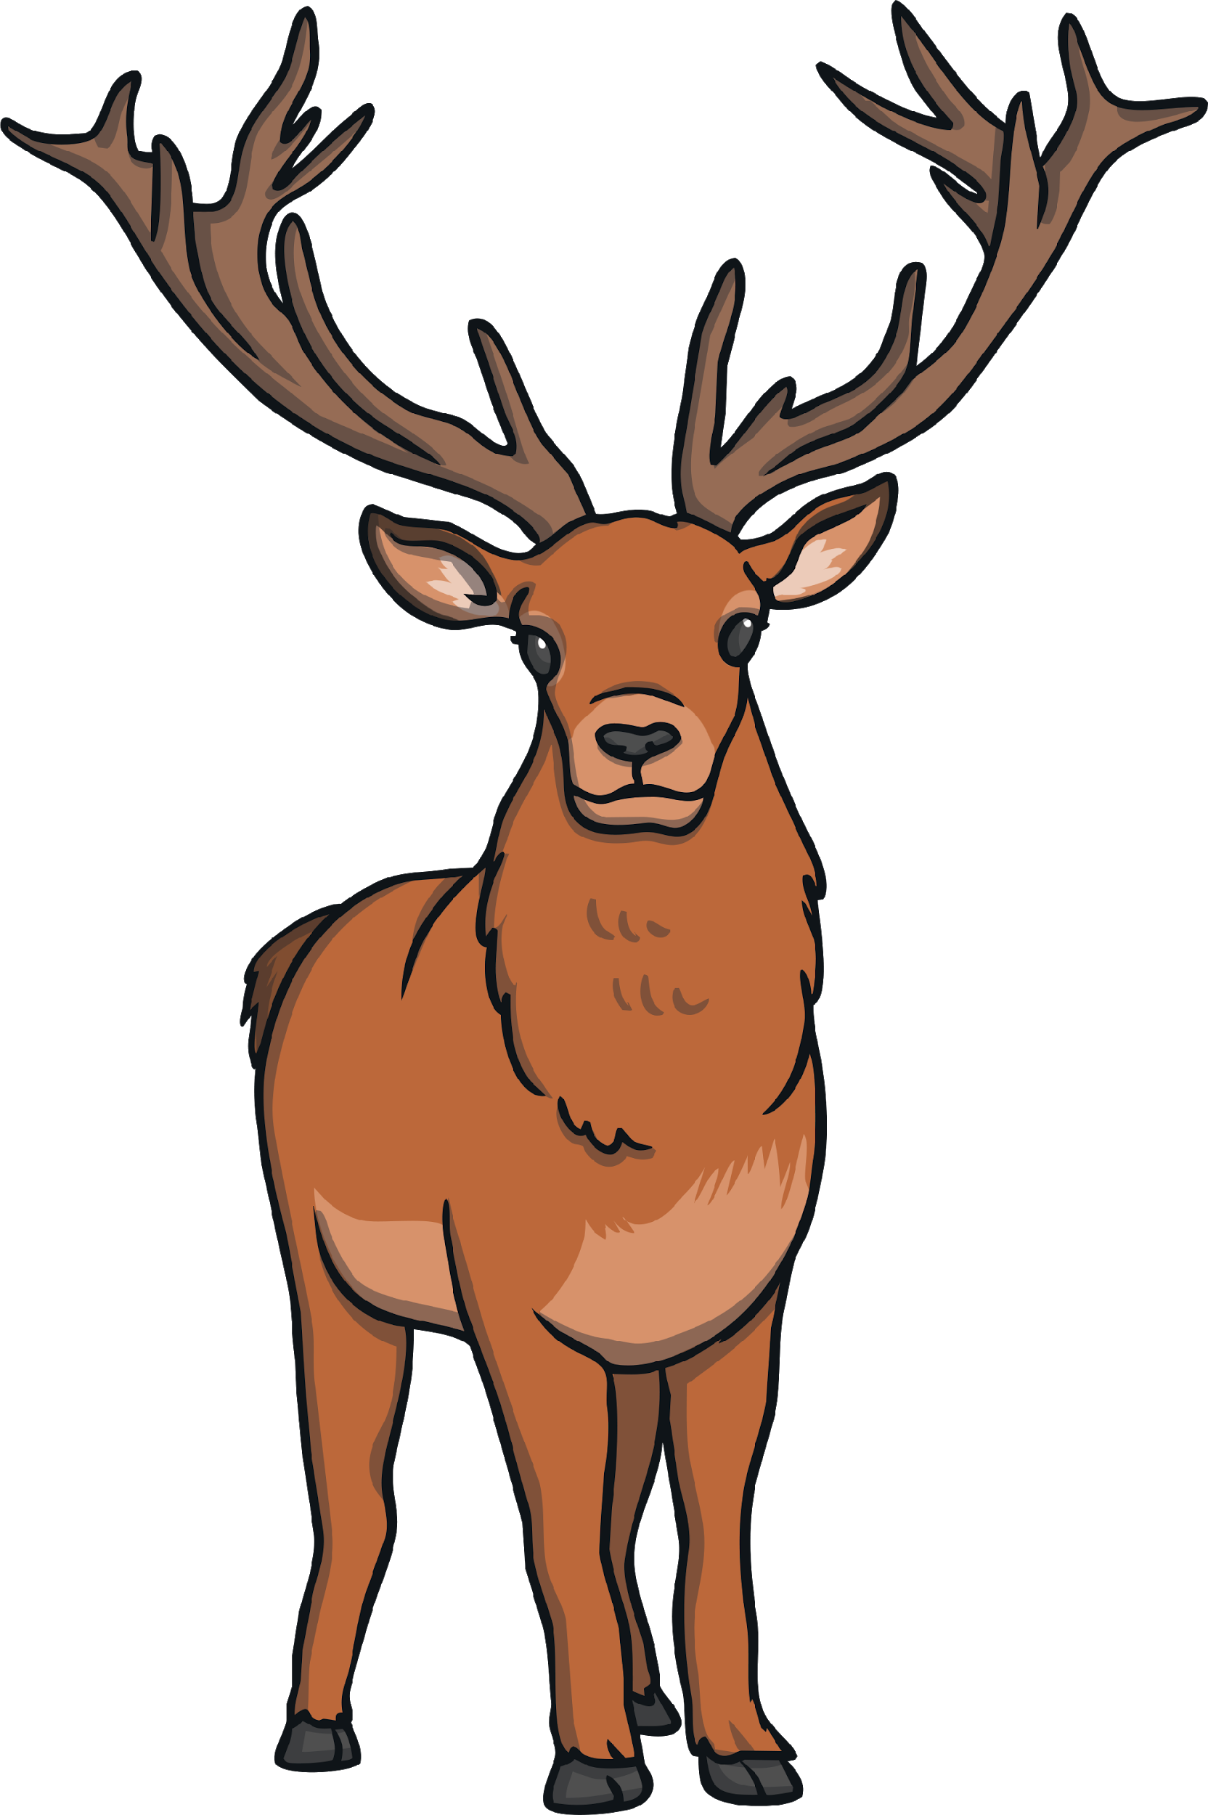
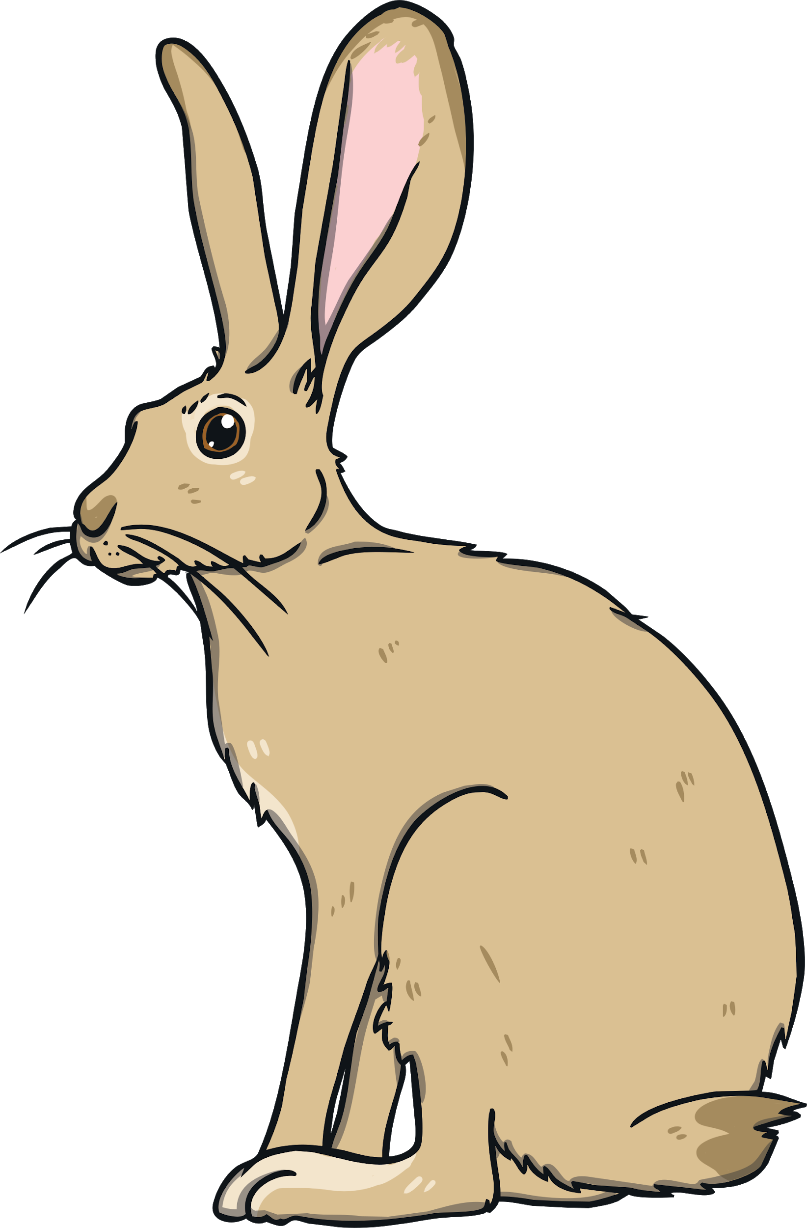
Herbivores
Herbivores are animals that only eat plants.
These can be flowers, fruit, nuts, grass or even wood.

Slide 18
You could remember the word:
Herbivore
by remembering that herbs are types of plants.
Notes:
This is a great addition!!

Slide 19
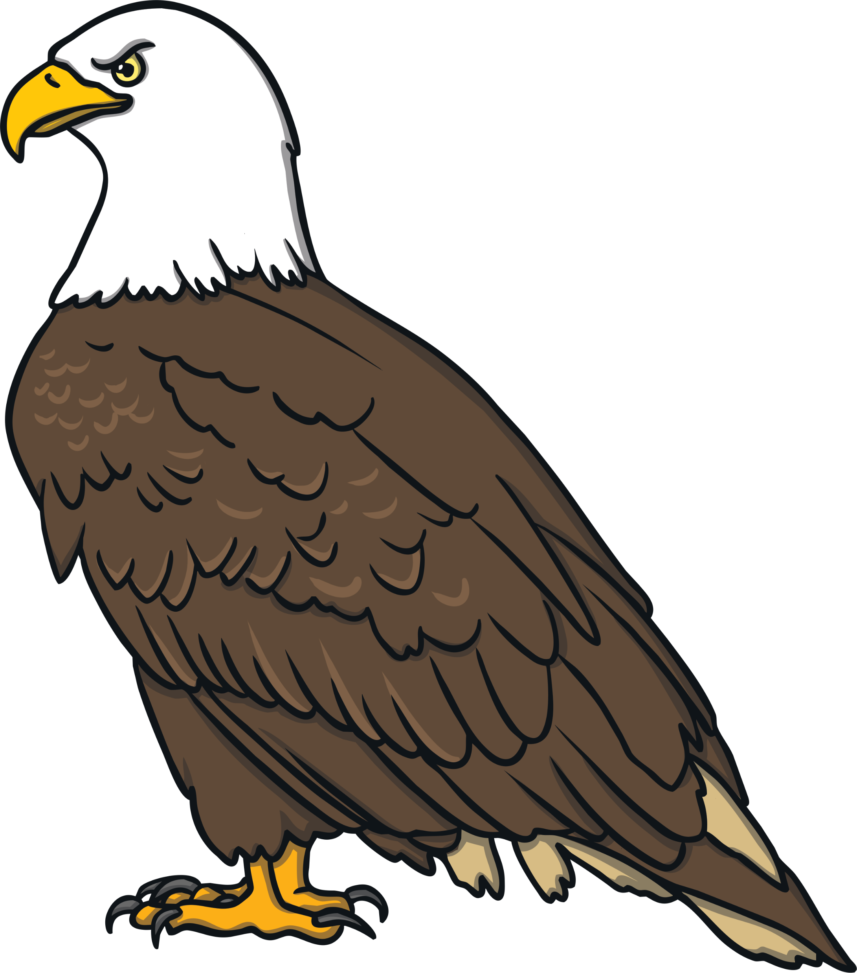
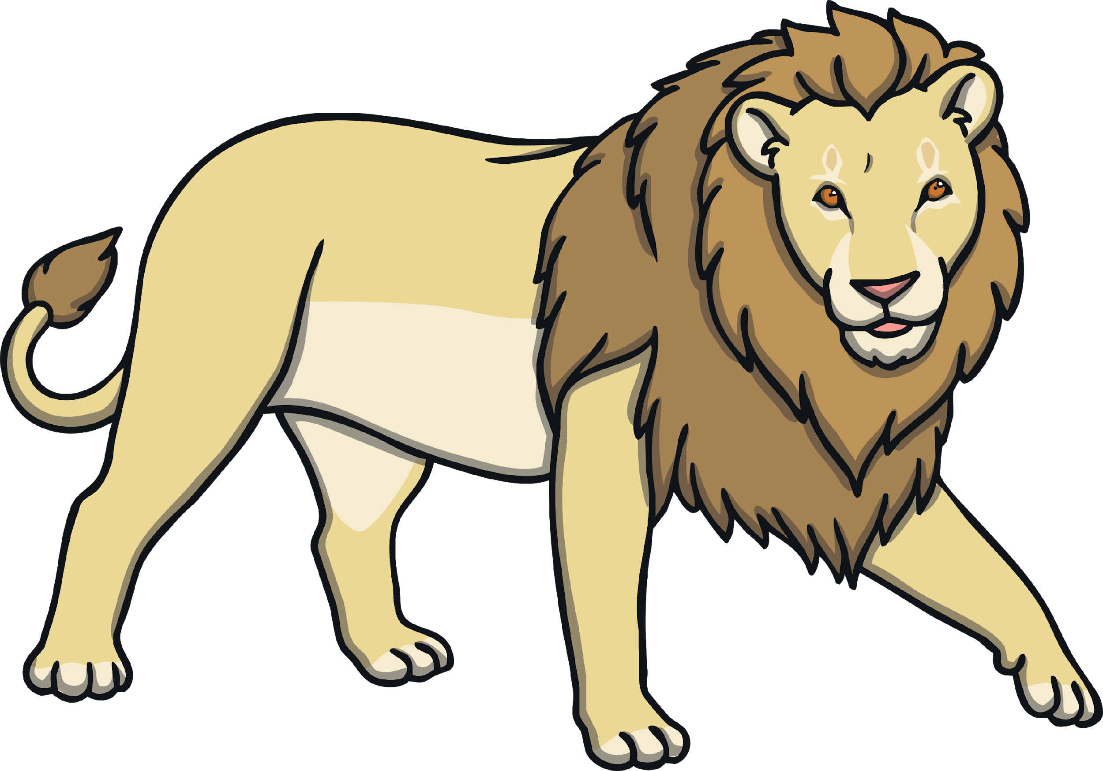
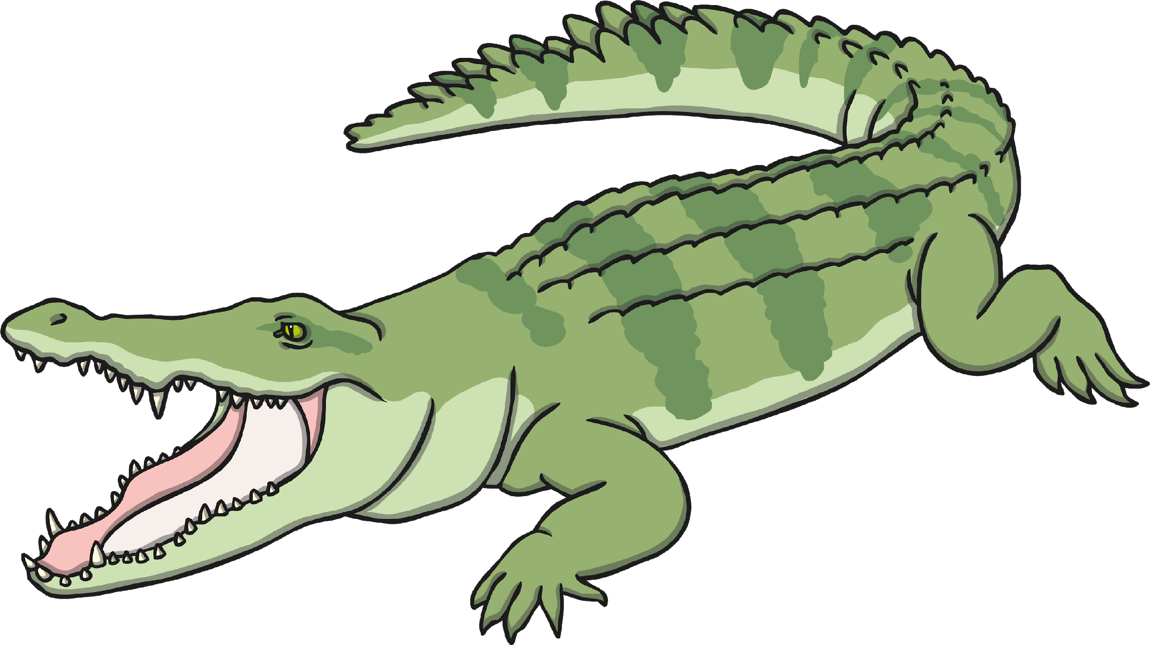
Carnivores
Carnivores are animals that only eat meat.
These animals have to catch animals to eat.

Slide 20
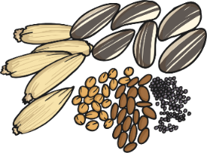
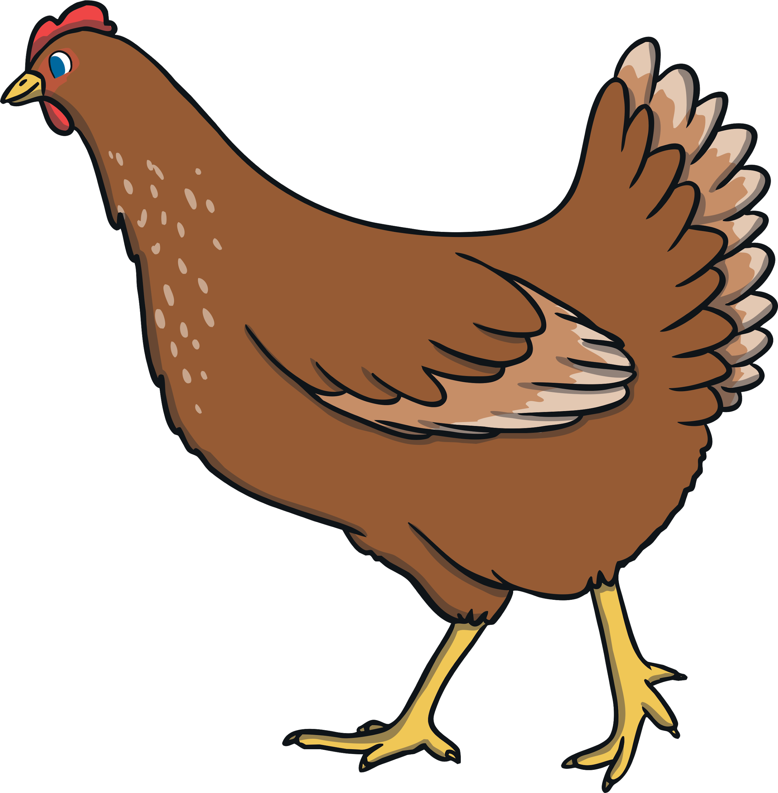
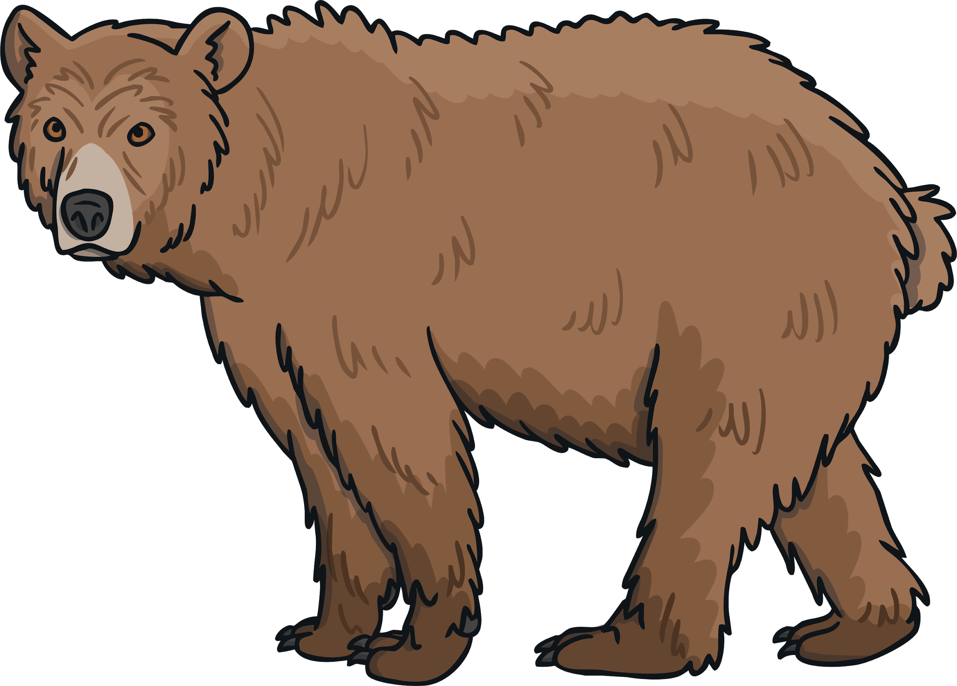
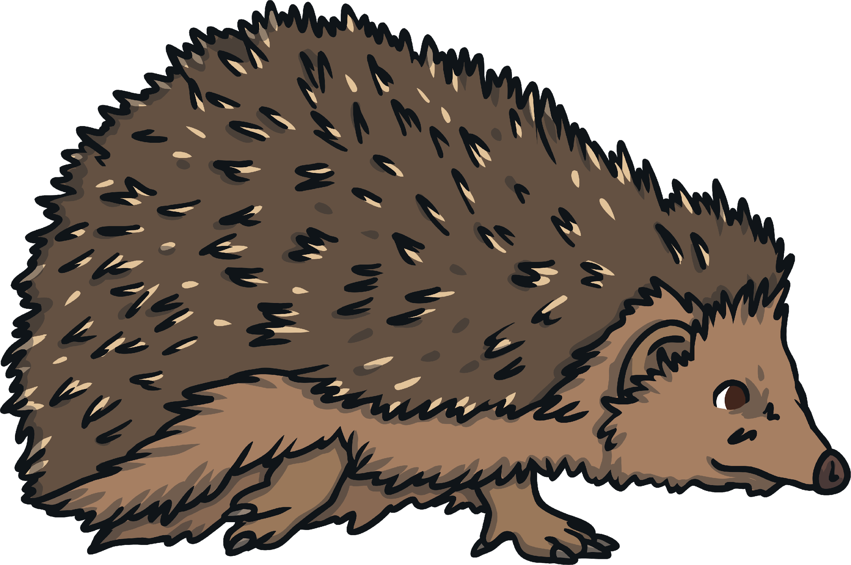
Omnivores
Omnivores are animals that eat meat and plants.
These are animals like chickens that can eat seeds and worms.

Slide 21
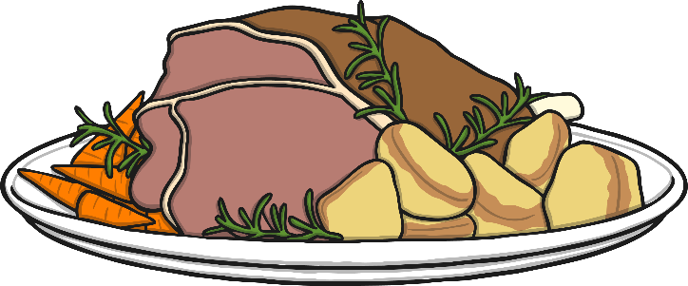
You could remember the word
Omnivore
by remembering that omnivores eat everything with an
om nom nom nom!

Slide 22
https://www.youtube.com/watch?v=RBMa-_3YXO4
Notes:
Now we will look at mammals, reptiles, amphibians, fish and birds. We will look at the different animals in these groups and some of their different features that classify them in these certain ways. We will watch a video to introduce the groups and then look at some characteristics afterwards.

Slide 23
What groups of animals were mentioned in the video?
Birds – wings, feathers, lay eggs, warm blooded.
Reptiles – scales NOT FUR, cold blooded, usually lay eggs (sometimes live babies), dry skin.
Amphibians – live on land & water, cold blooded, lay eggs, moist skin, webbed feet.
Mammals – give birth to live young, hair or fur, nurse live young with milk, warm blooded.
Fish - breath under water using gills, have scales and fins, lay eggs, cold blooded.
To remember these you can remember BRAMF!
What invertebrate group was mentioned nearer the end?
Insects!

Slide 24
Your task - can you group animals in more than one way.
Can you explain your choices?
Joshua, you can email your choices to me.

