Slide 1
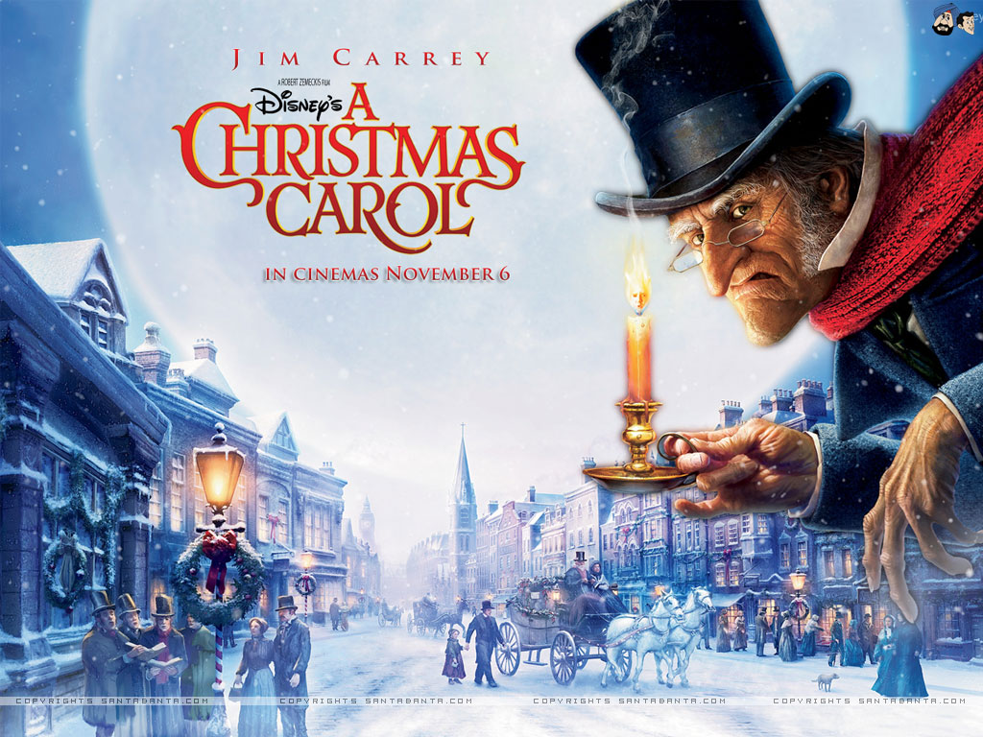
LO: write a character description Friday 20th November 2020

Slide 2
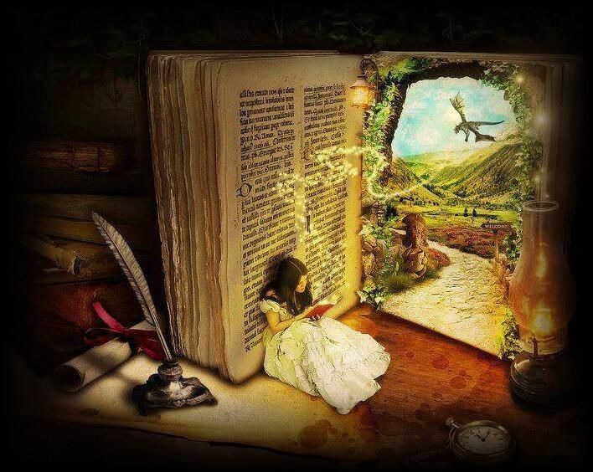
Visualisation
Open your eyes and visualise!
Use the words to create a mental picture.
See what you read,
Feel what you read,
Draw what you read!
Make a movie in your mind.
I can imagine...
I am picturing...
Visualisation creates a personal link between the reader and the text- this makes the book more meaningful.
Your ‘movie’ will change as you read more- everyone will see a different picture!

Slide 3
I can use figurative language to write a character description.
Simple sentences -
just one clause
compound sentences- FANBOYS conjunctions
Similes - compare using ‘as’ or ‘like’
Complex sentences - I SAW A WABUB

Slide 4
I can use figurative language to write a character description.
Personification - giving human qualities to a non-human object
Metaphor - compare by suggesting two things are the same

Slide 5
I can use figurative language to write a character description.
Describe the character’s appearance and personality.
Consider what their actions tell us about their character.

Slide 6
Your task...
Write a character description about the first spirit.
Use the checklist to help you!

Slide 7
Your task...
As bright as a bolt of lightning, the spirit illuminated Scrooge’s chamber creating eerie, elongated shadows which danced across the walls and ceiling. Scrooge shielded his eyes.
The spectre, who was as small as a child, wore a gleaming white tunic and clasped a sprig of emerald green holly in one pale, wrinkled hand.
The light emerging from the crown of its head made the phantom appear almost angelic, except that it had no wings. Instead, this supernatural visitor hovered ominously at the foot of Scrooge’s four poster bed, barefoot despite the chill of the bleak winter’s night.
Unlike Jacob- who was bound in heavy clanking chains -this ghost was free of shackles and its long silvery white hair floated in strands around its strange face as if it were underwater.

