Slide 1
Wednesday 18th November
Maths

Slide 2
What are we learning?
I can multiply by 3.

Slide 3
Watch the video
https://vimeo.com/475444169

Slide 4
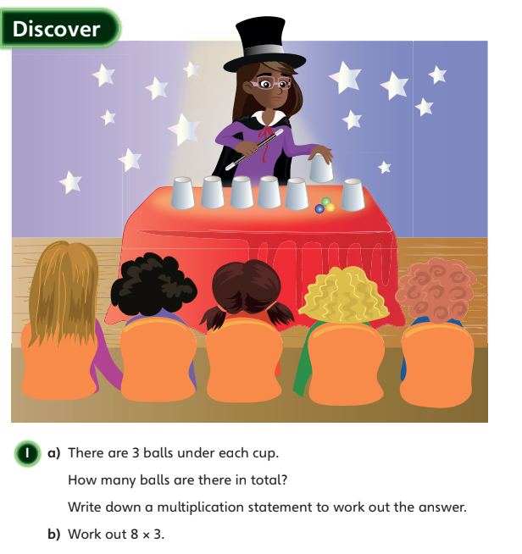

Slide 5
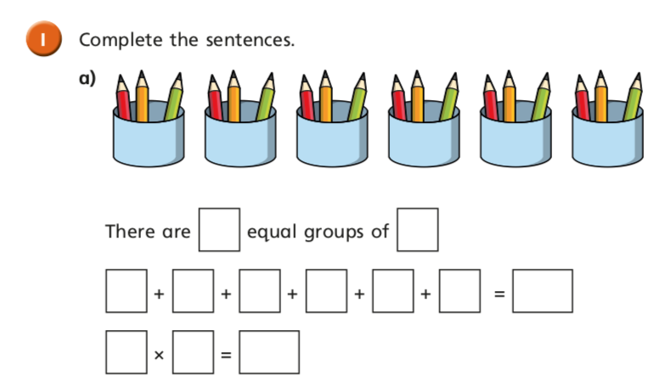

Slide 6
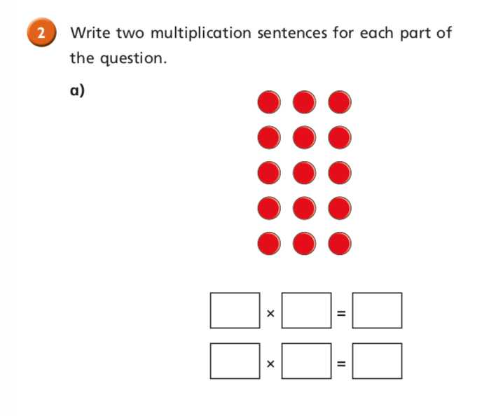

Slide 7
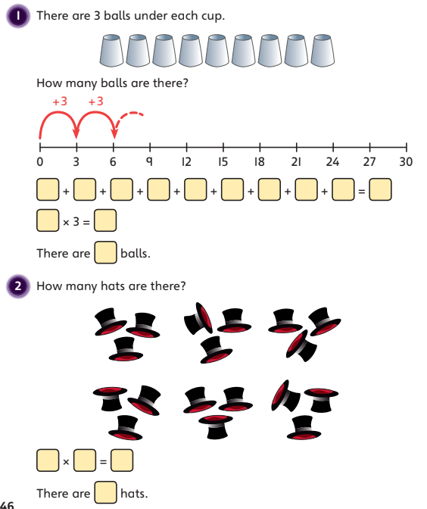
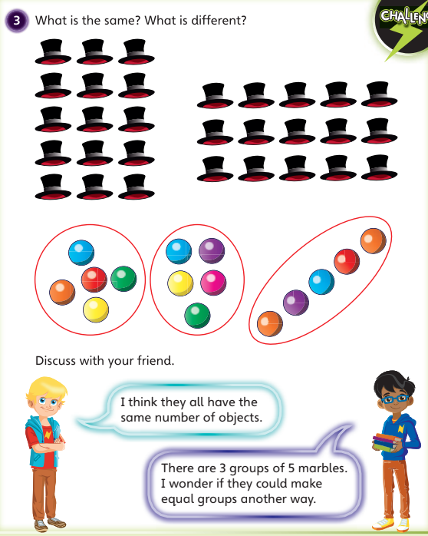

Slide 8
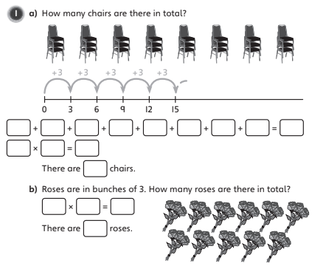

Slide 11
