Slide 1
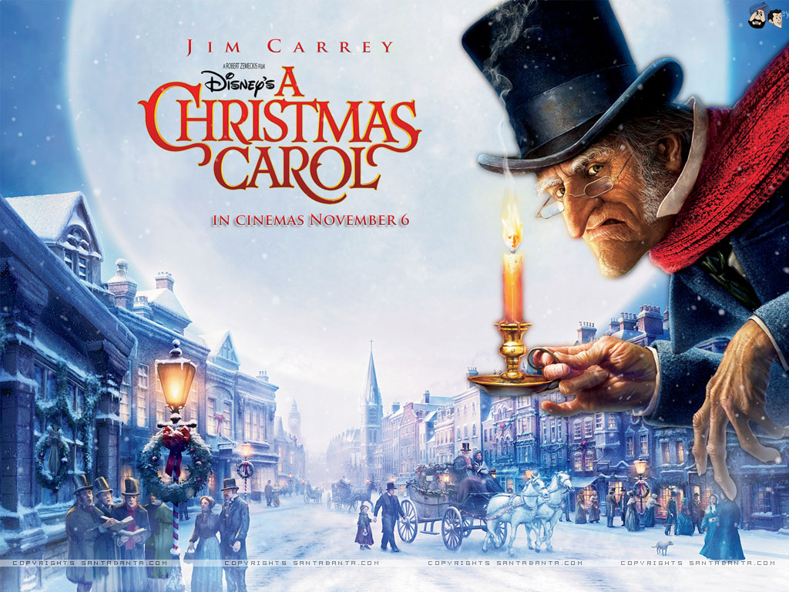
LO: to write a character interview Tuesday 1st December 2020

Slide 2
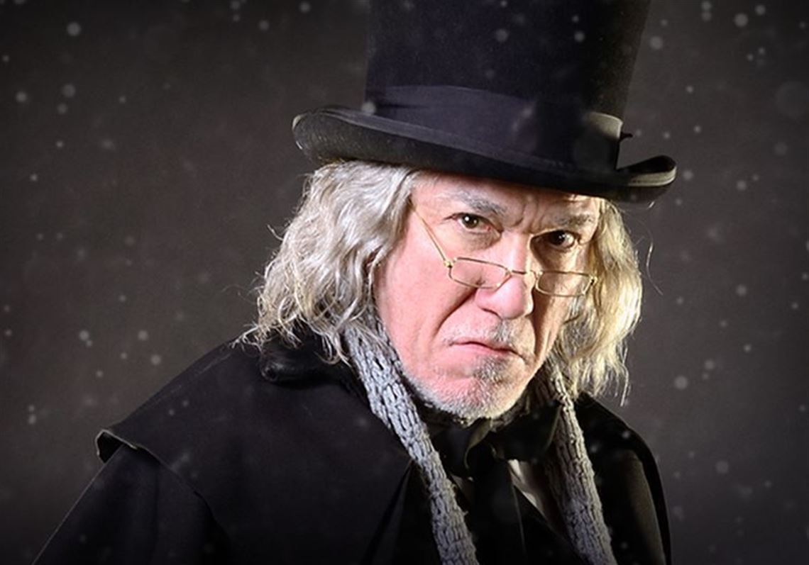
Today we will write-up our interview!

Slide 3
Think back to the questions we composed in yesterday’s lesson and the answers that Scrooge gave…
Mr. Scrooge, what made you so bitter?
How did you feel when you saw Marley’s face in your door knocker?
What was it about Master Fezziwig that made him a good employer?
What sort of employer do you think you’ve been to Bob Cratchit?
Do you have any regrets after what the Ghost of Christmas Past revealed to you?
How did you feel when your unloving father sent you away to boarding school?
So far, what has frightened you the most about being visited by the ghosts?

Slide 4
https://prezi.com/jugfiin01ouf/character-interview-of-scrooge/

Slide 5
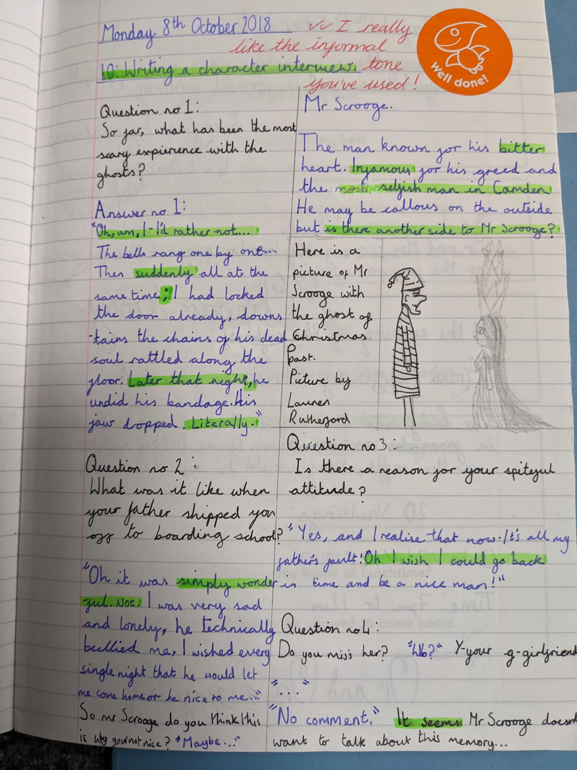
A good example… what makes it successful?

Slide 6
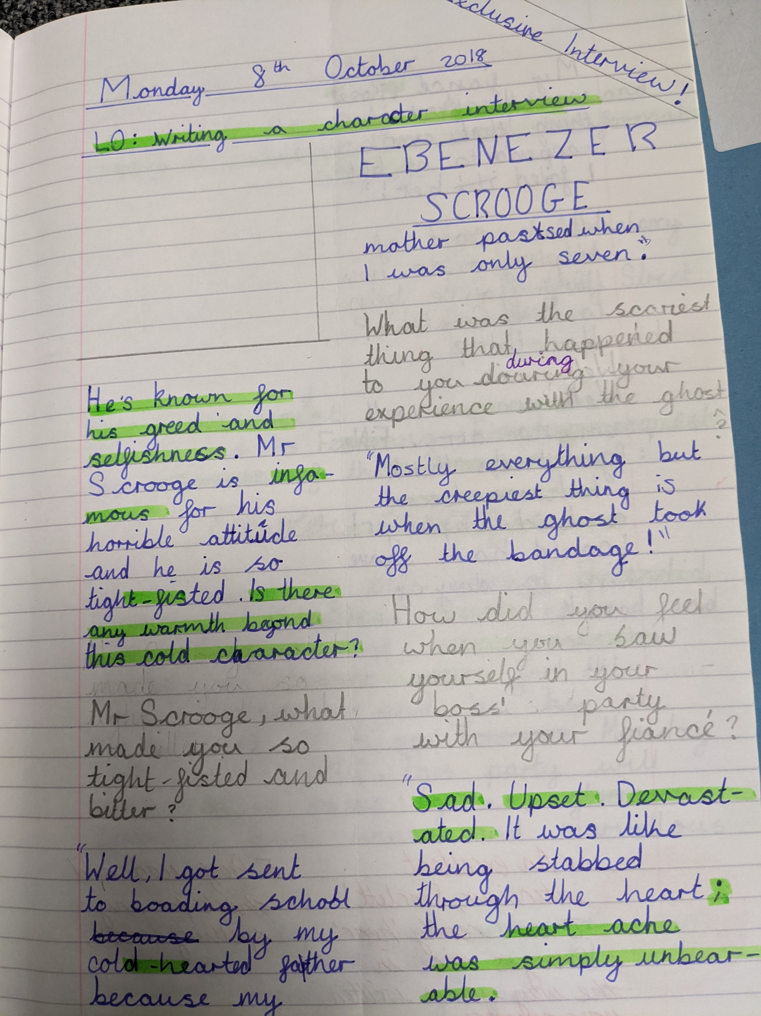

Slide 7
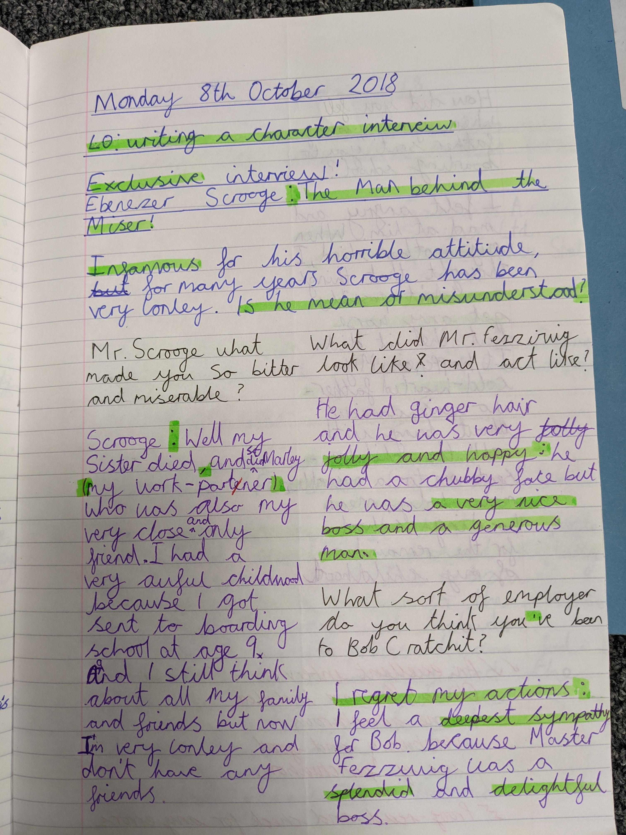

Slide 8
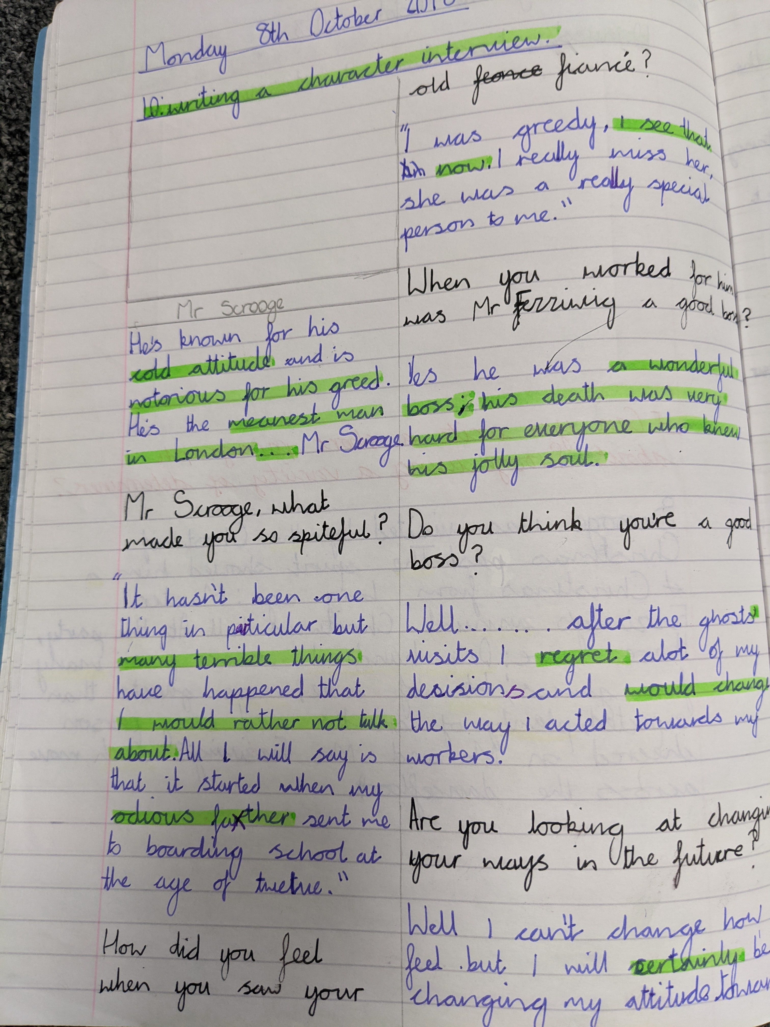

Slide 9
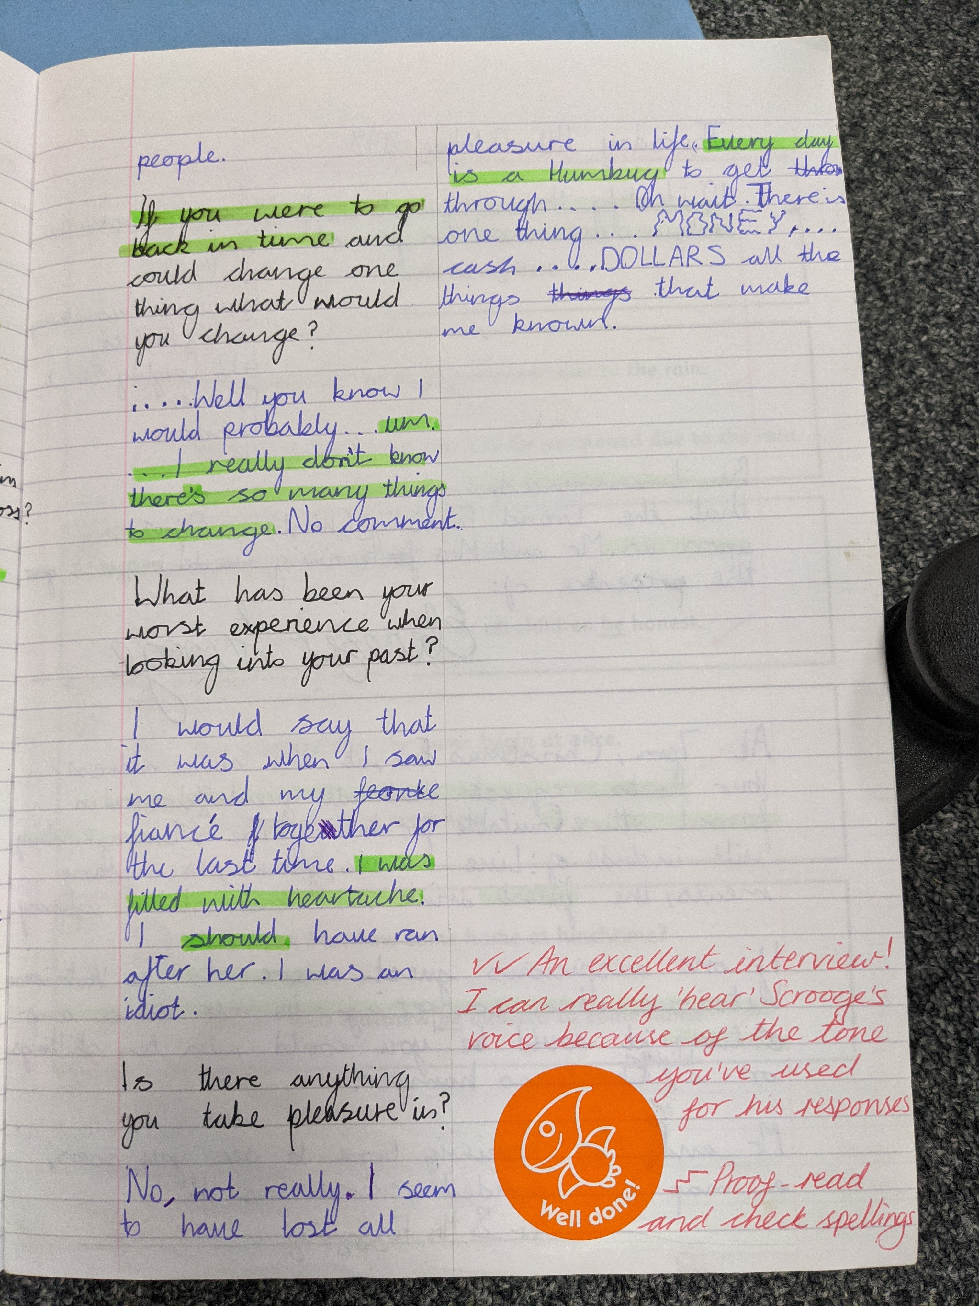

Slide 10
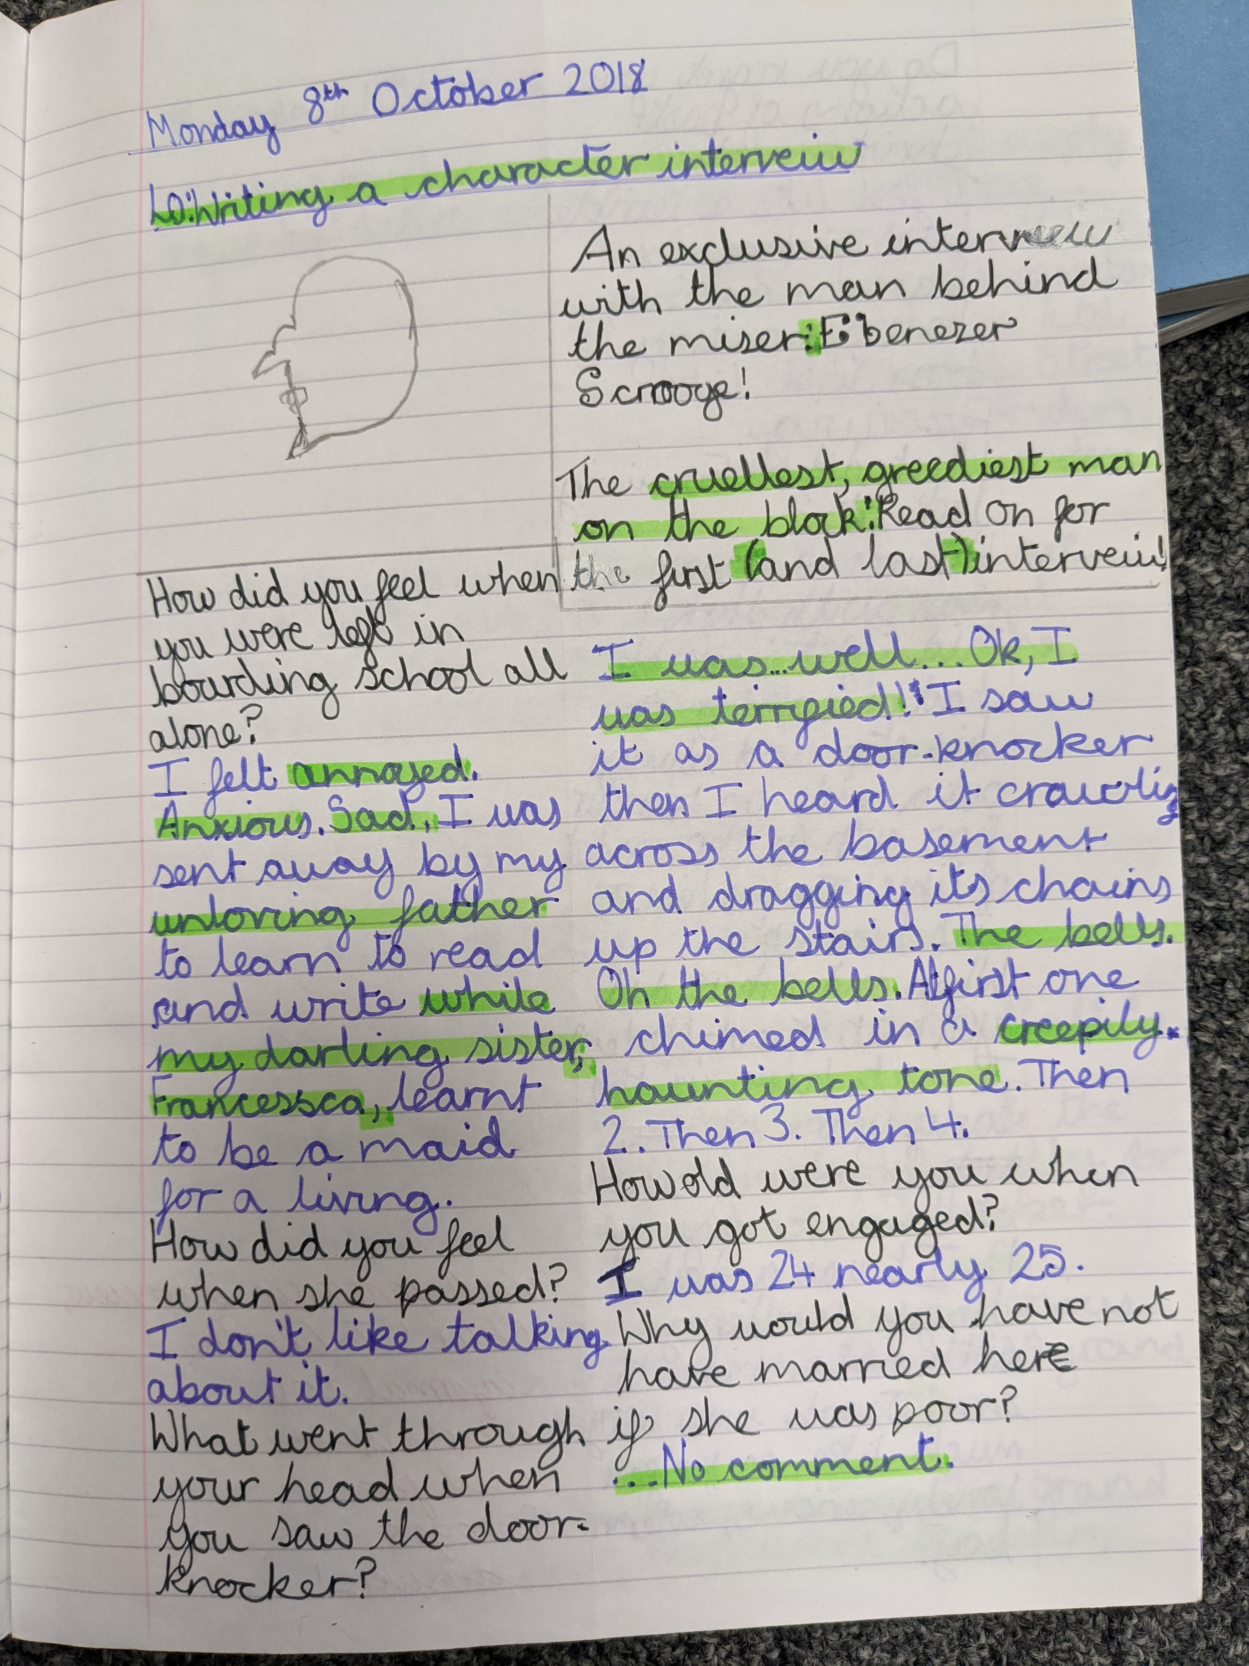

Slide 11
